Slide 1
Example of a class: a case study
Class name is Time1 to represent time of a day
private instance variables to represent time format
hour
minute
second
public methods /public services/public interfaces to clients
setTime()
toUniversalString() : universal time format(HH:MM:SS)
toString(): for standard time format (H:MM:SS)

Slide 2
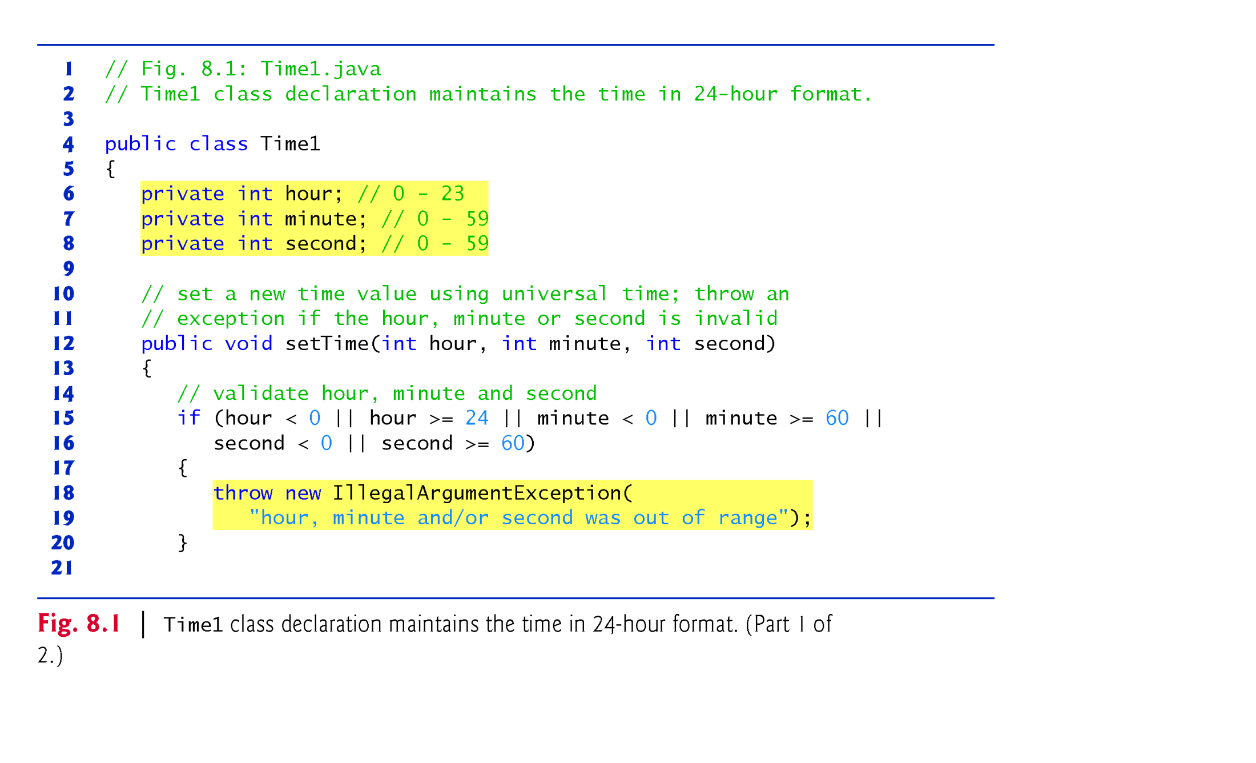
Example 1: “Time1” Class as case study(1/2)
Line 18: “new” creates an object on heap and then “throws” the reference of the object back to the caller to be cached(we will study in ch 11 )

Slide 3
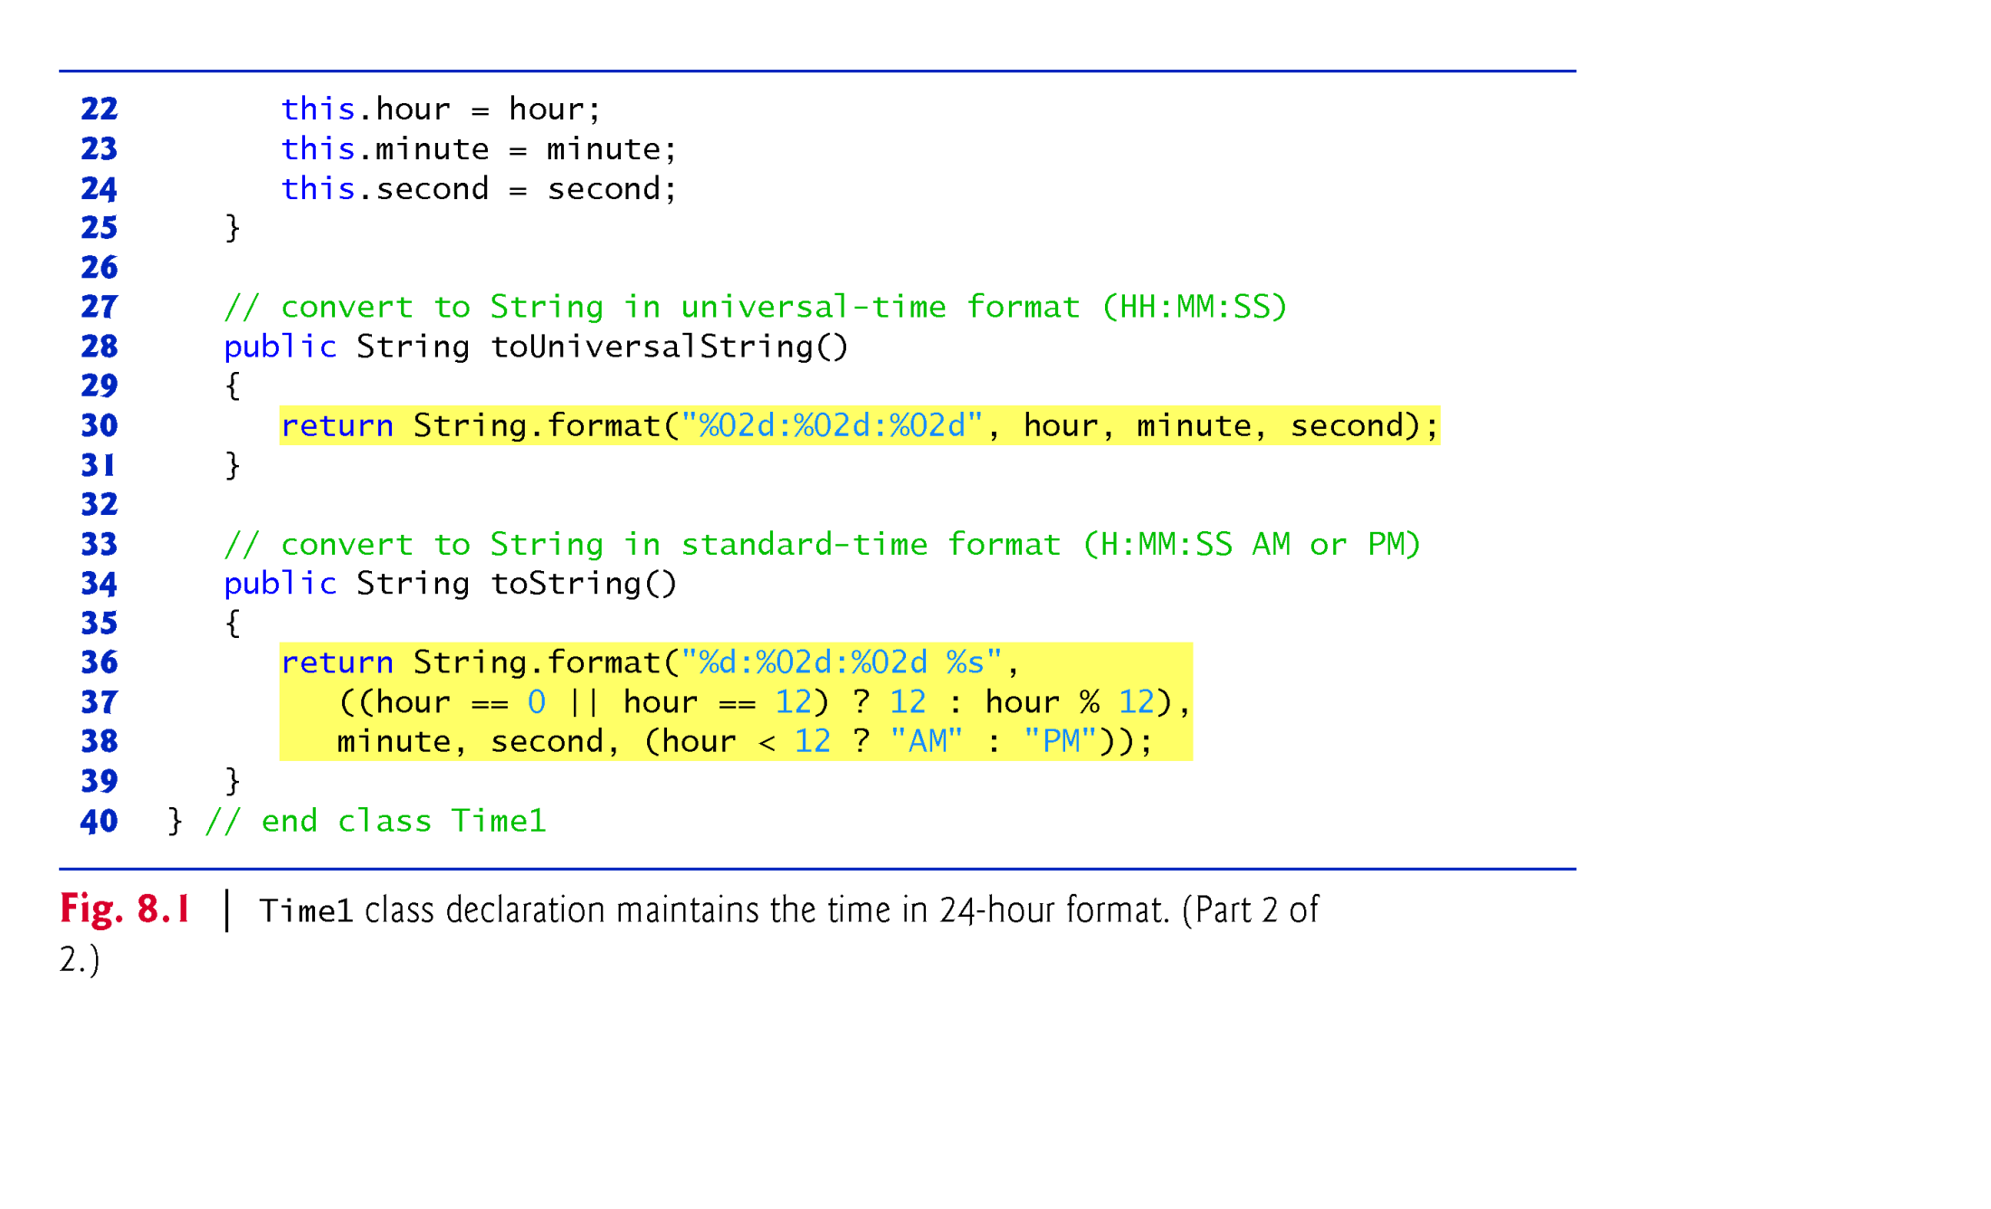
Example 1: “Time1” Class as case study(2/2)

Slide 4
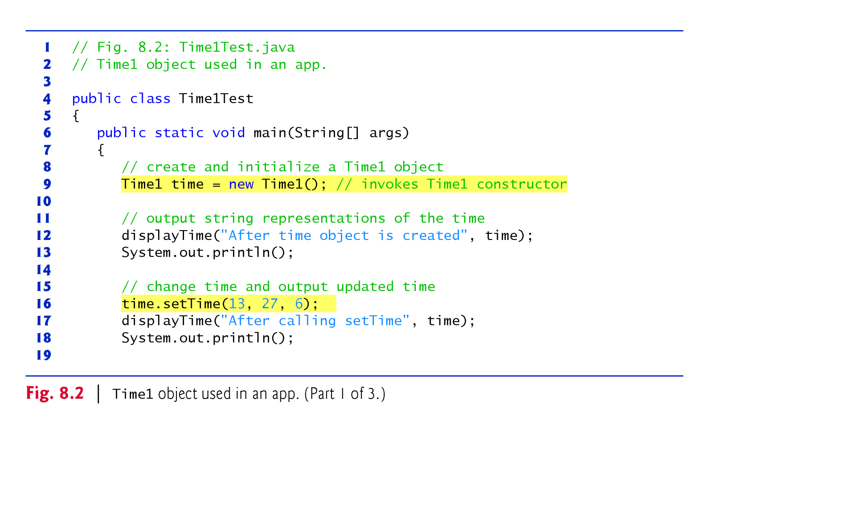
Example 1: “Time1Test” Class as case study(1/3)
Line 9: The client class invoking constructor but the server class has no explicit constructor and it is inserted by compiler

Slide 5
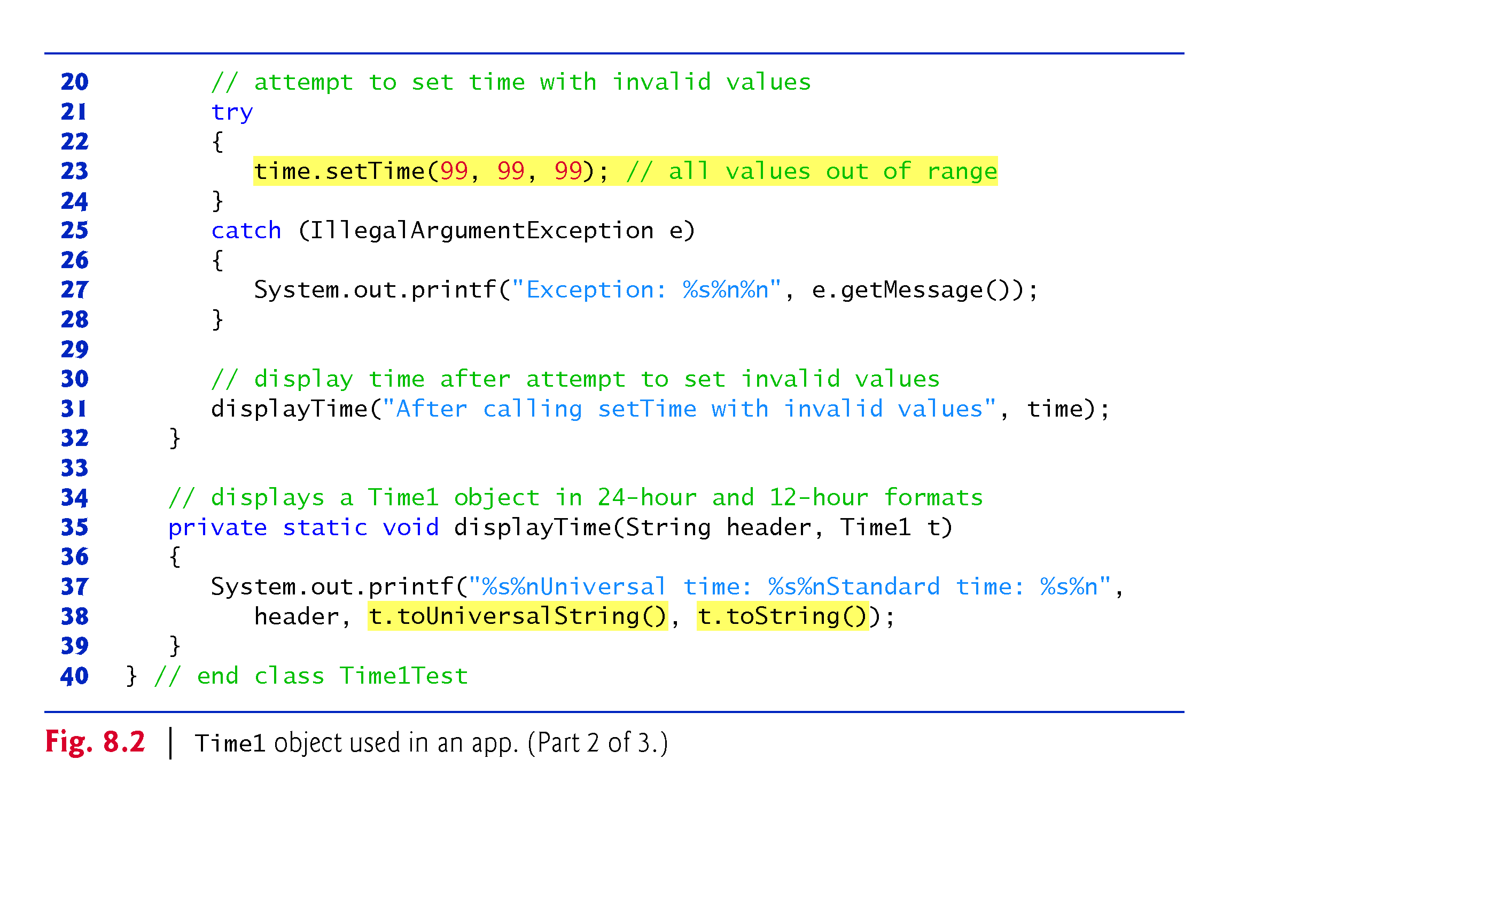
Example 1: “Time1Test” Class as case study(2/3)

Slide 6
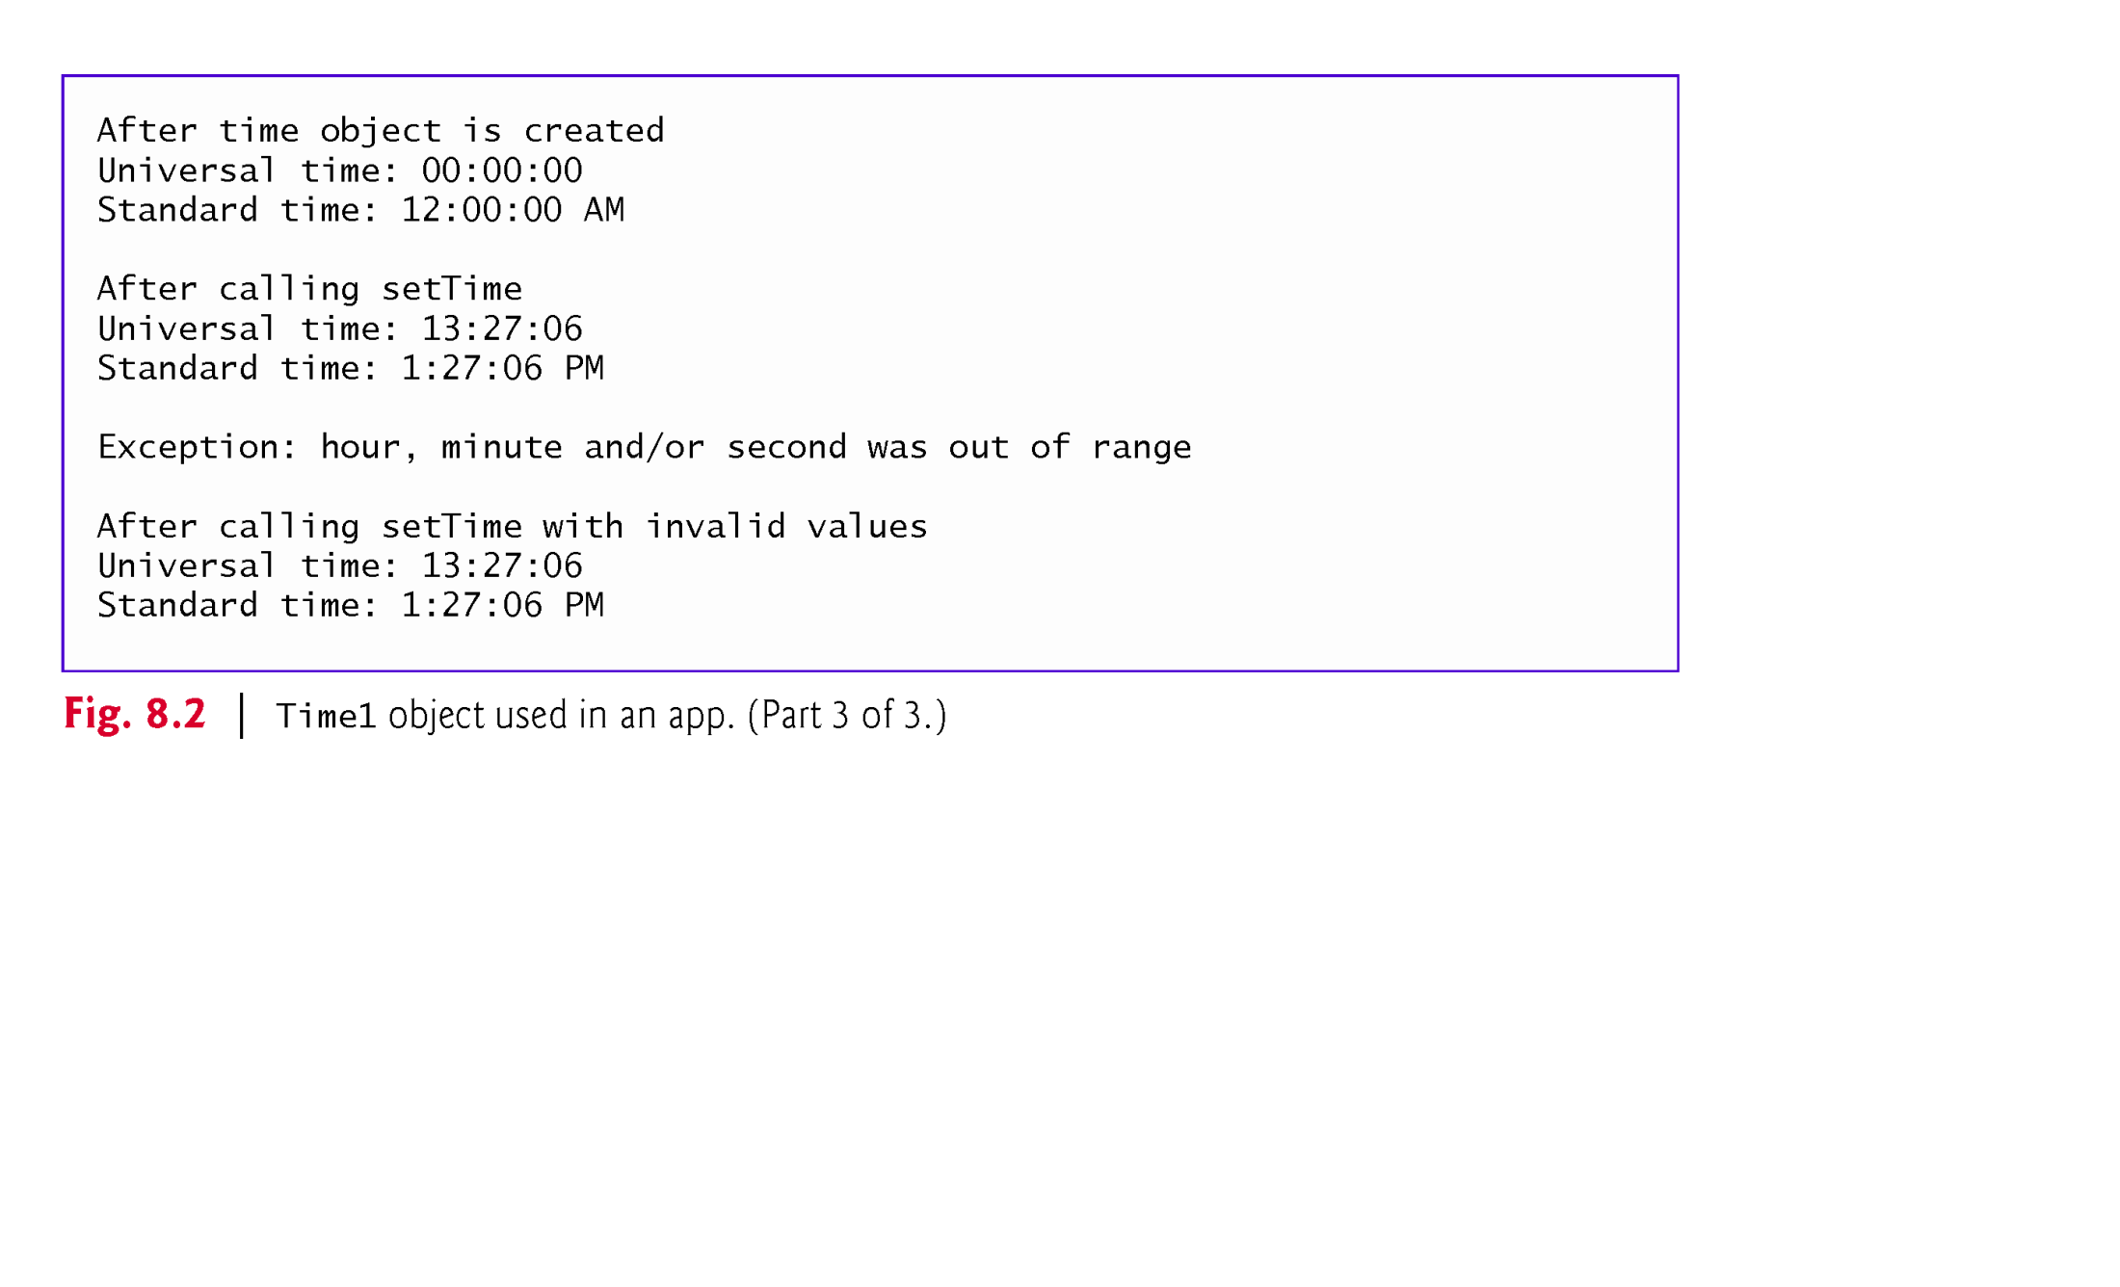
Example 1: Class as case study(3/3): Output

Slide 7
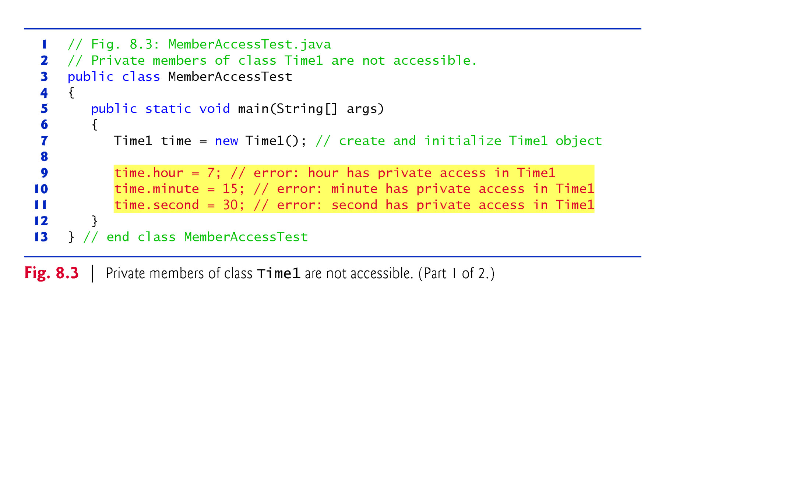
Example 2: Accessibility of Member Fields

Slide 8
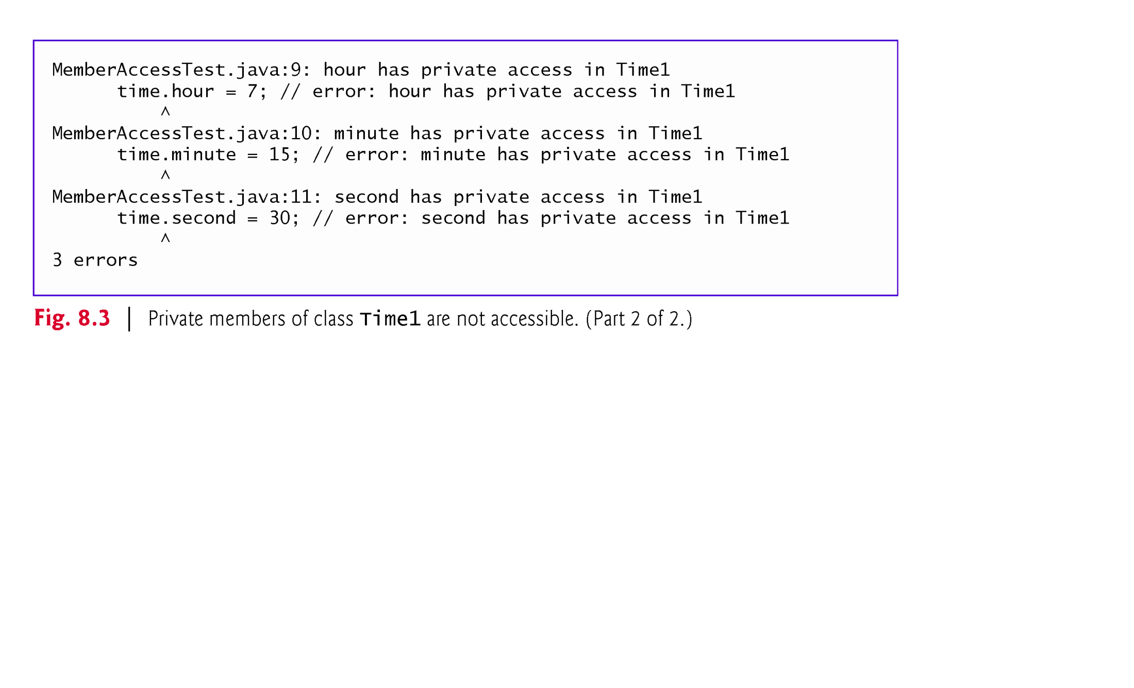
Example 2 : Accessibility of Member Fields:
Display Compilation Error

Slide 9
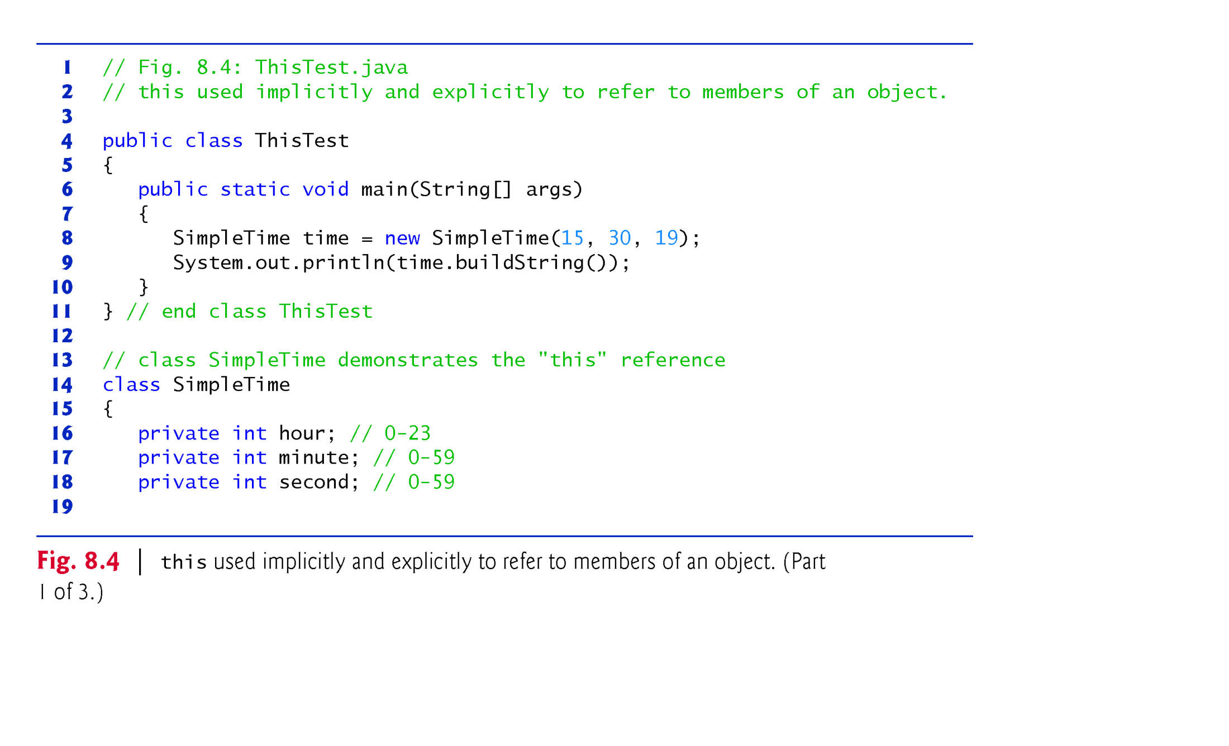
Example 3: The use of “this” reference(1/3)
Two classes with the same source file but we get two “.class” files
“SimpleTime” class is accessed only by ”ThisTest” class
// Line 8: new SimpleTime (15, 30,19, this);
// Line 9: System.out.println( time.buildingString(this) );

Slide 10
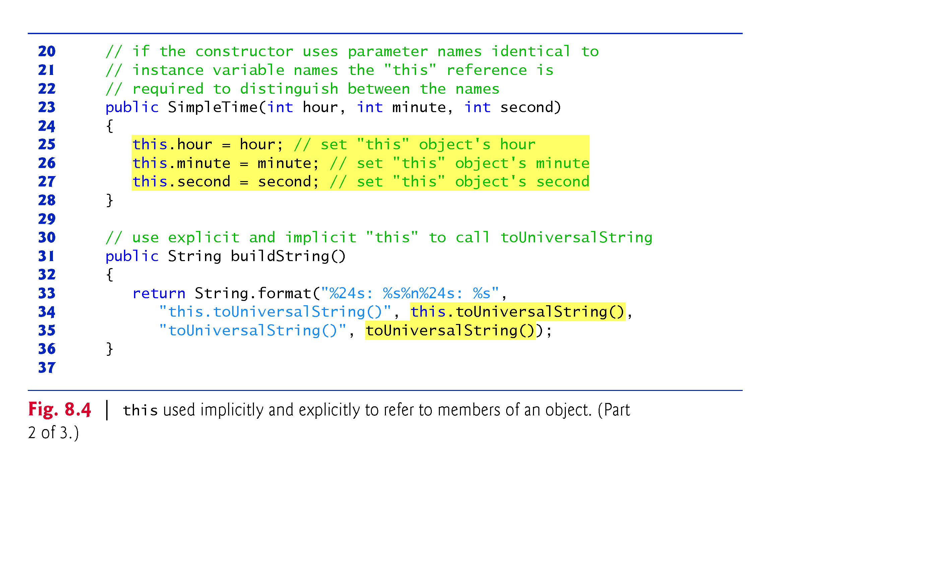
Example 3: The use of “this” reference(2/3)
// Lines 23: SimpleTime(hour,minute,second, this)
// Line 31: public String buildString(this)
// At line 25-27, “this” reference is mandatory, but optional at line 34. Why?

Slide 11
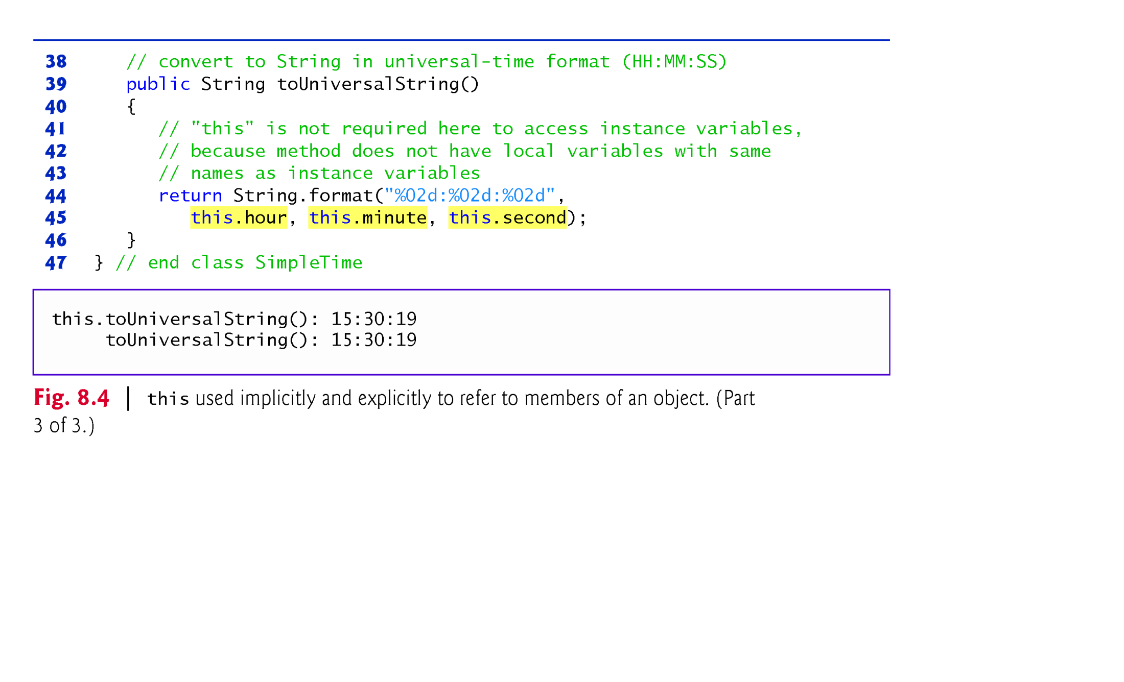
Example 3: The use of “this” reference(3/3)
// Line 39: public String toUniversalString(this )
// at line 45, using “this” reference is optional .Why ?

Slide 12
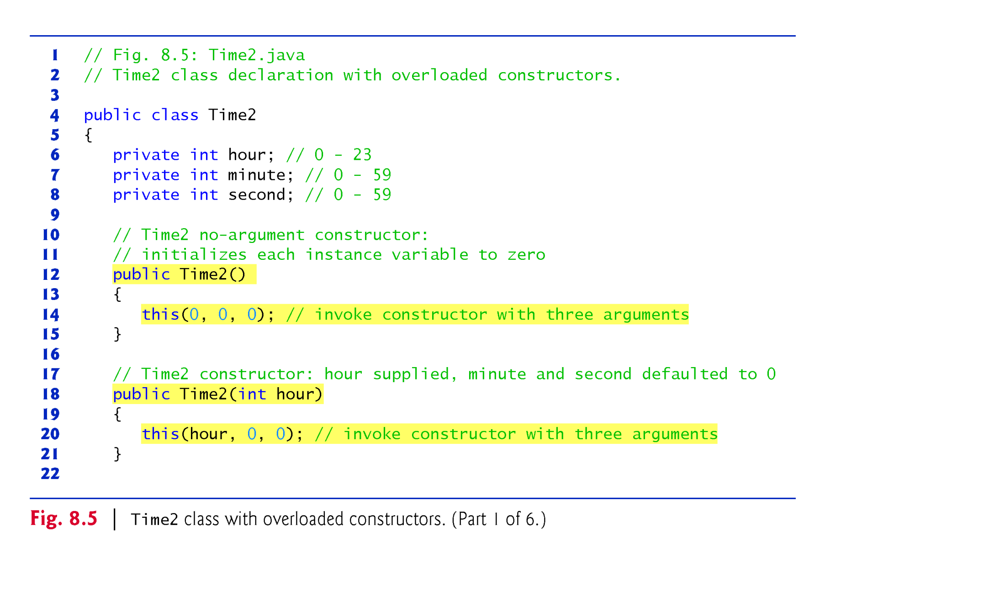
Example 4: Overloaded constructor: “Time2” Class(1/6)
Line 12: Compiler will not insert default constructor automatically because programmer did
Cons-1
Cons-2
Line 14: “this()” should be first statement in constructor’s body

Slide 13
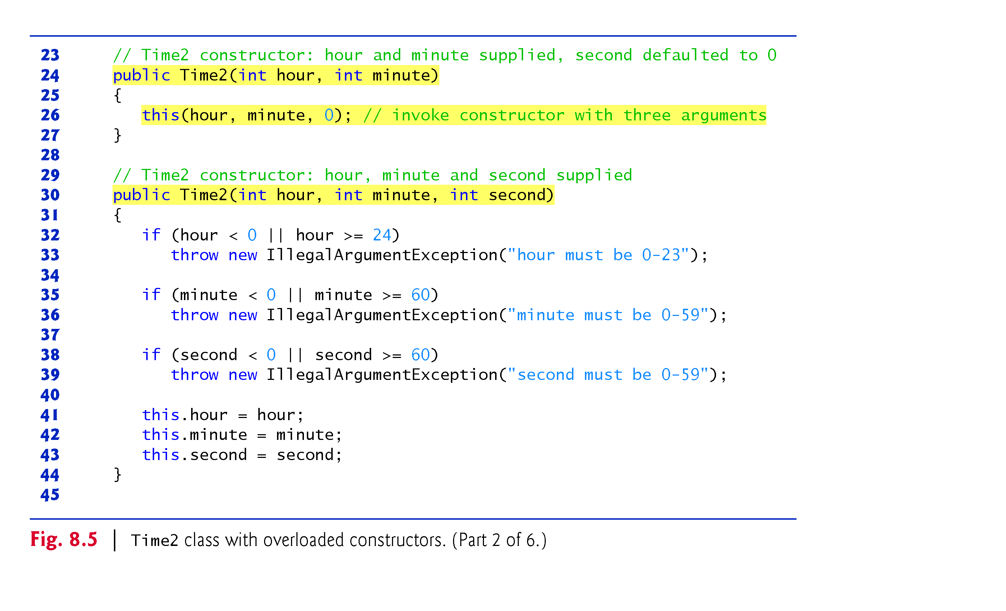
Example 4: Overloaded constructor: “Time2” Class(2/6)
Cons-3
Cons-4
Why Con-1,Cons-2,Cons-3, and Cons-5 did note coded like cons-4 without using “this”?
Answer ………………………………………….. ?

Slide 14
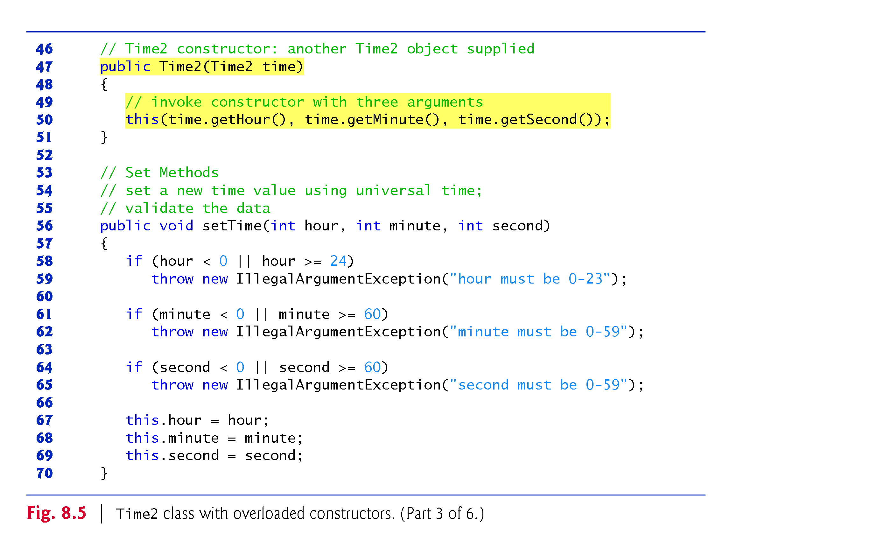
Example 4: Overloaded constructor: “Time2” Class(3/6)
Cons-5

Slide 15
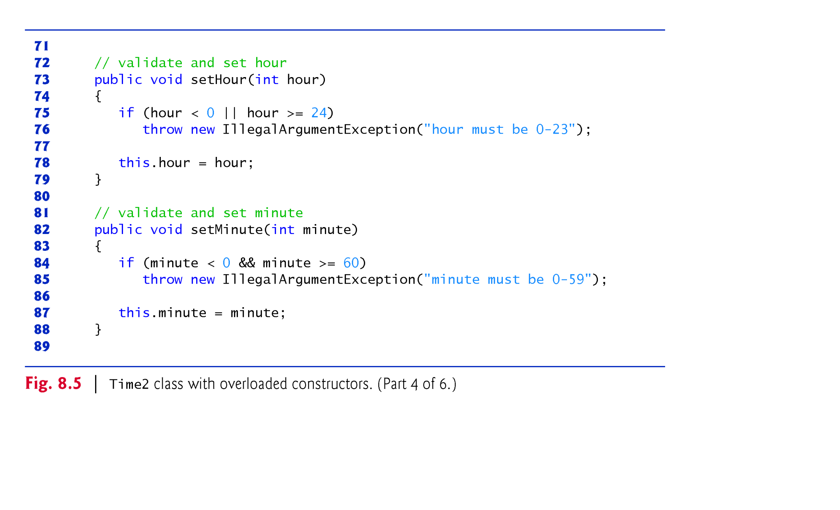
Example 4: Overloaded constructor: “Time2” Class(4/6)

Slide 16
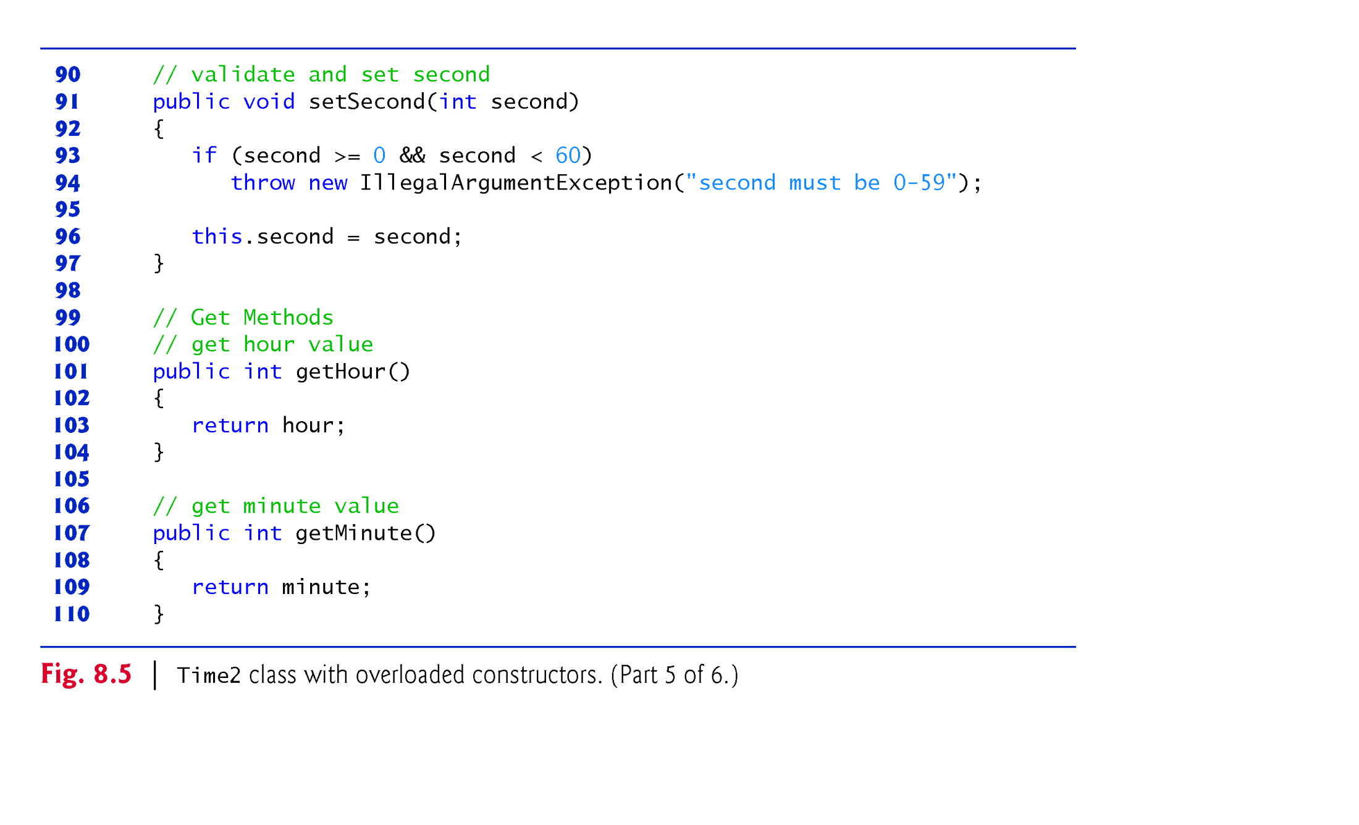
Example 4: Overloaded constructor: “Time2” Class(5/6)

Slide 17
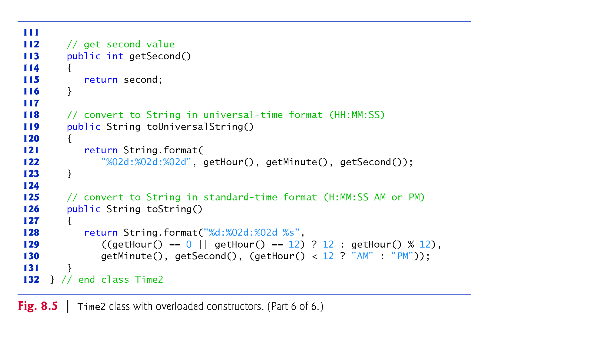
Example 4: Overloaded constructor: “Time2” Class(6/6)
Line 122/129: Member fields can be accessed directly. Why we need getX()? Hint: Assume complete time is represented by 4 bytes to store total seconds instead of 12 bytes (3x4?
Answer:

Slide 18
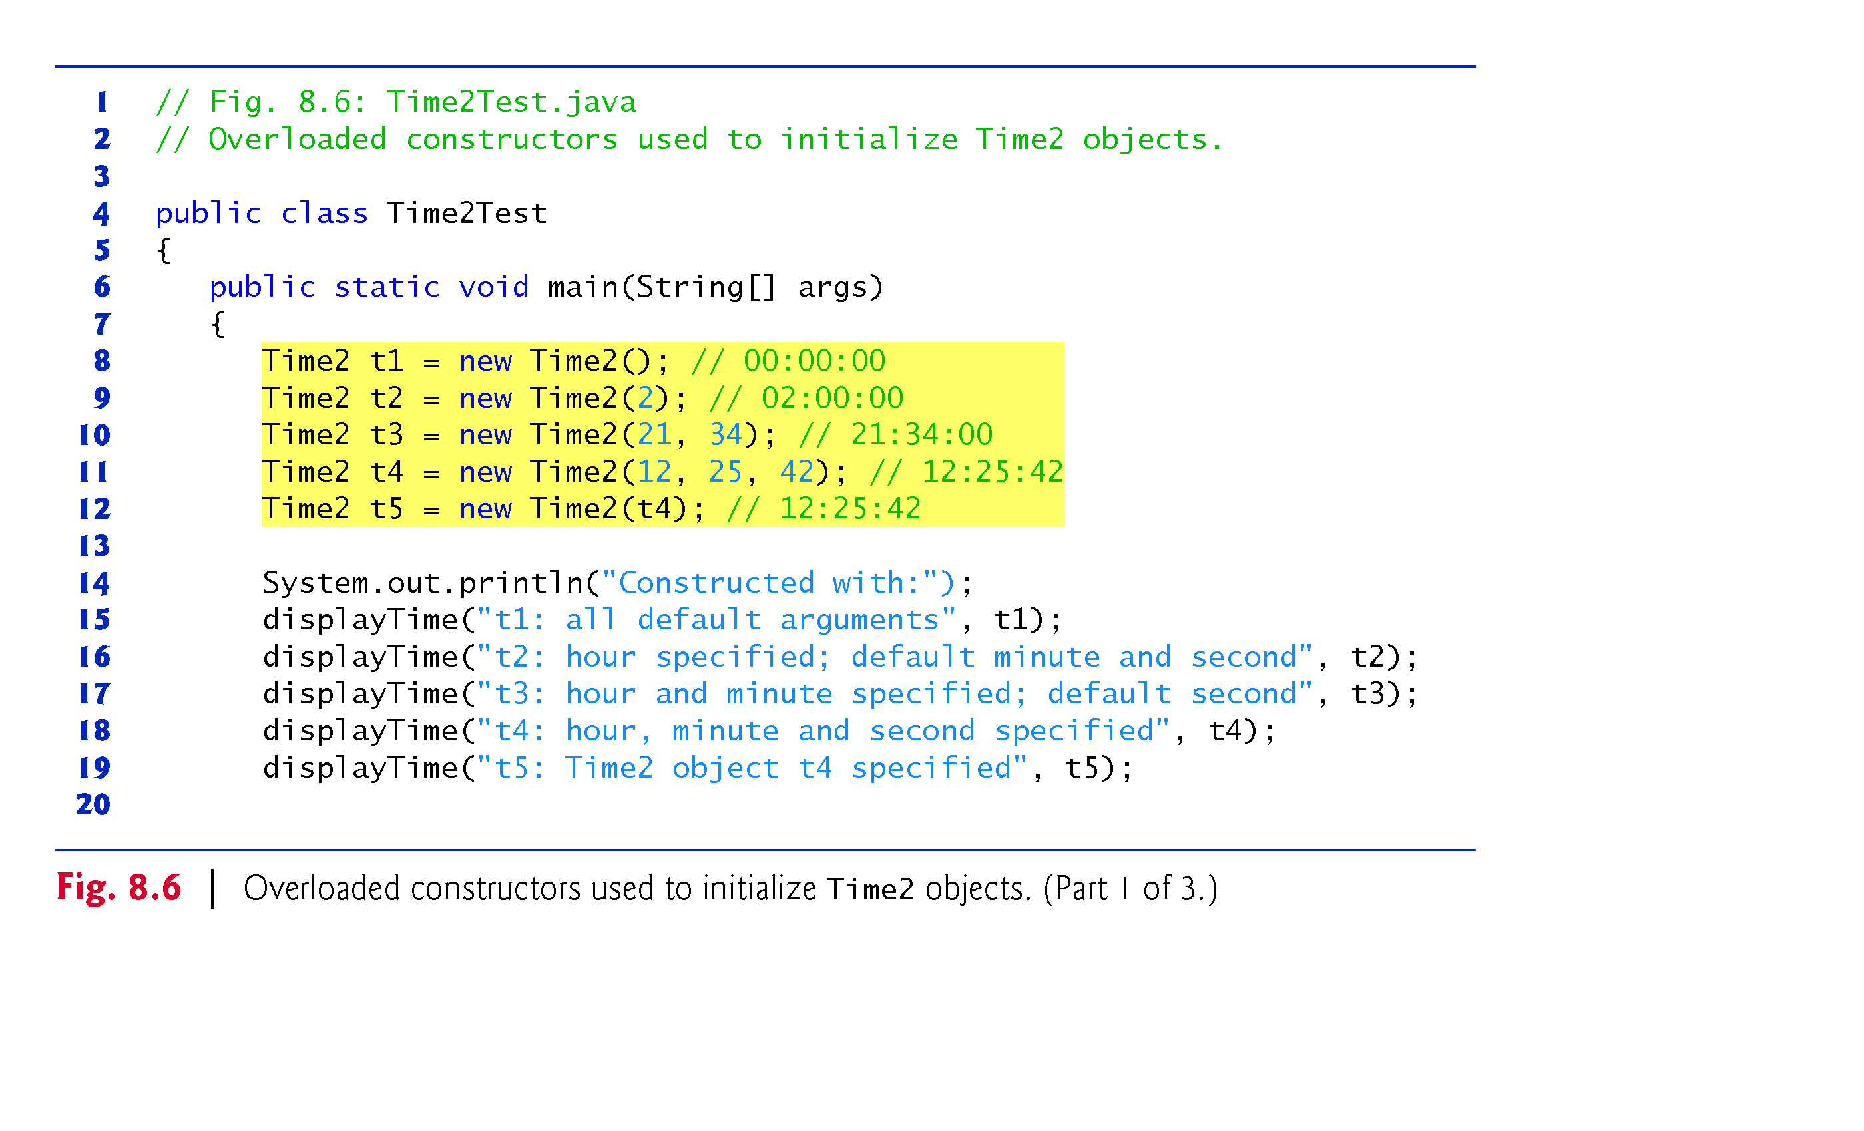
Example 4: Overloaded constructor: “Time2Test” Class(1/3)

Slide 19
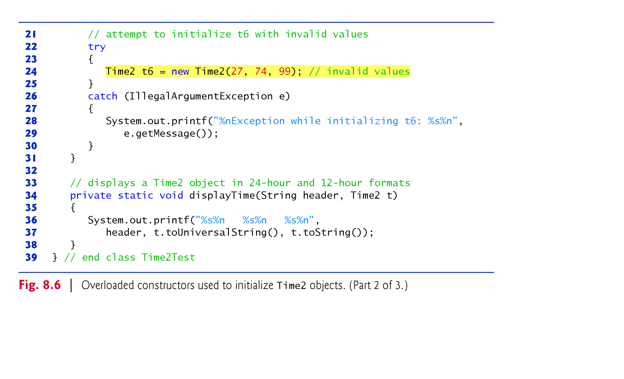
Example 4: Overloaded constructor: “Time2Test” Class(2/3)

Slide 20
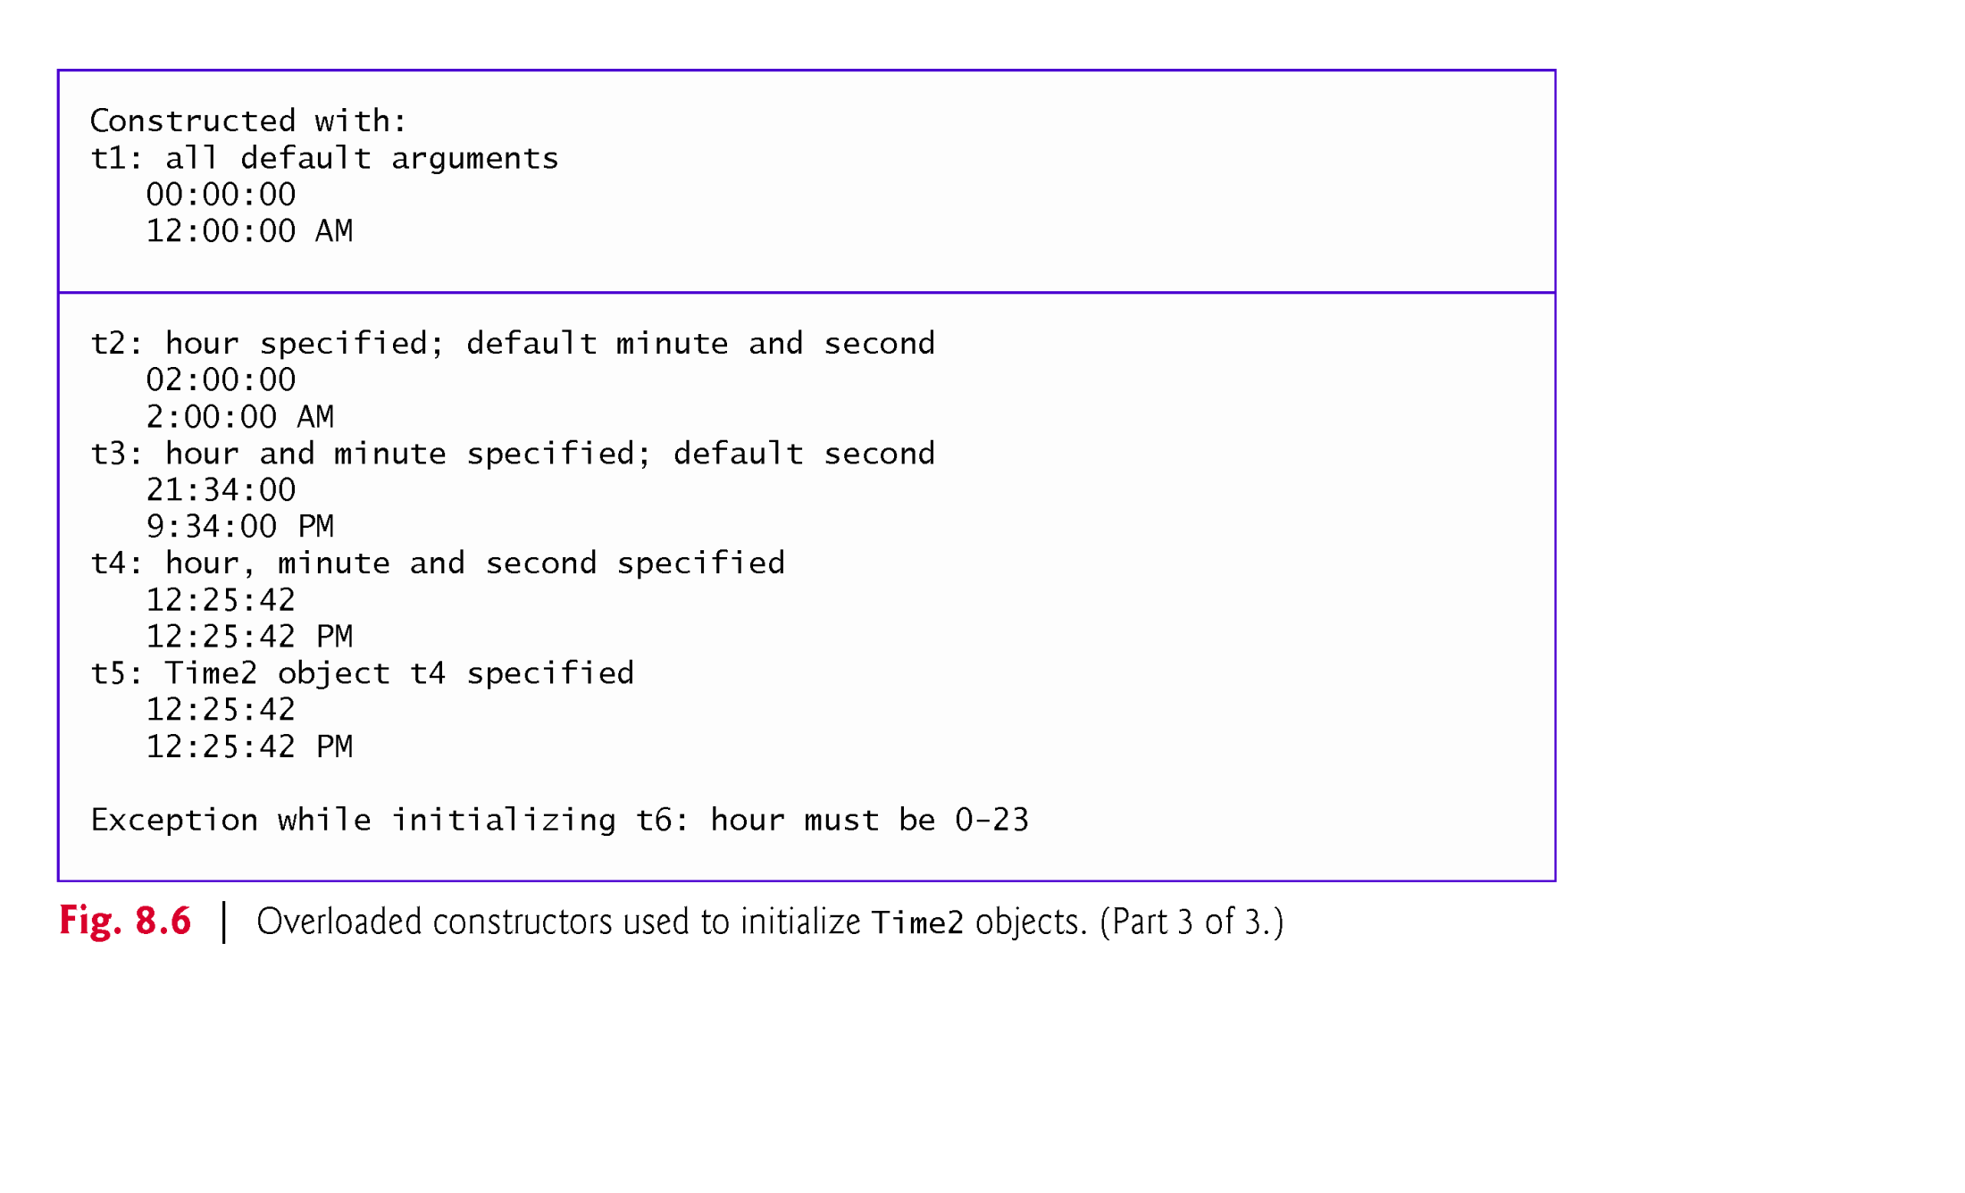
Example 4: Overloaded constructor: Screen Output (3/3)

Slide 21
Example of Composition(Has-a Relationship)
A class can have references to objects of other classes as its data members.
This is called composition or has-a relationship.
Example: An “Employee” object has “Date” object as its attribute.
Employee
Class
Has-a
Date
Class

Slide 22
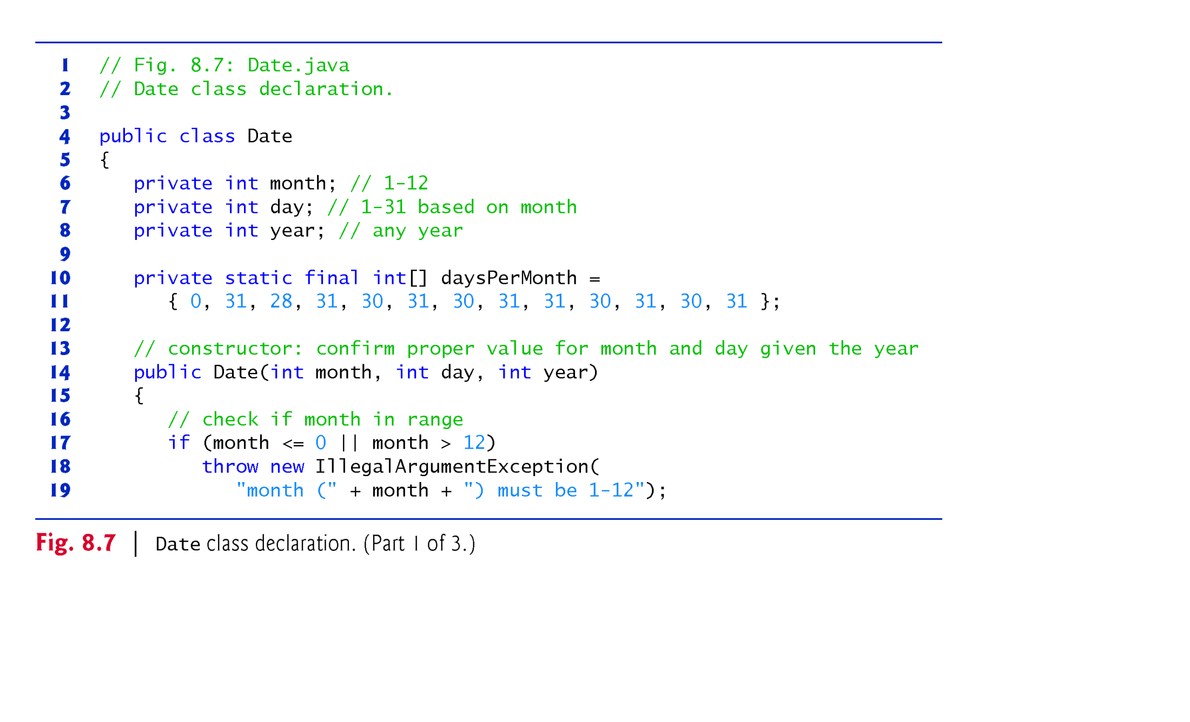
Example 5 for Has-A : Date class(1/3)

Slide 23
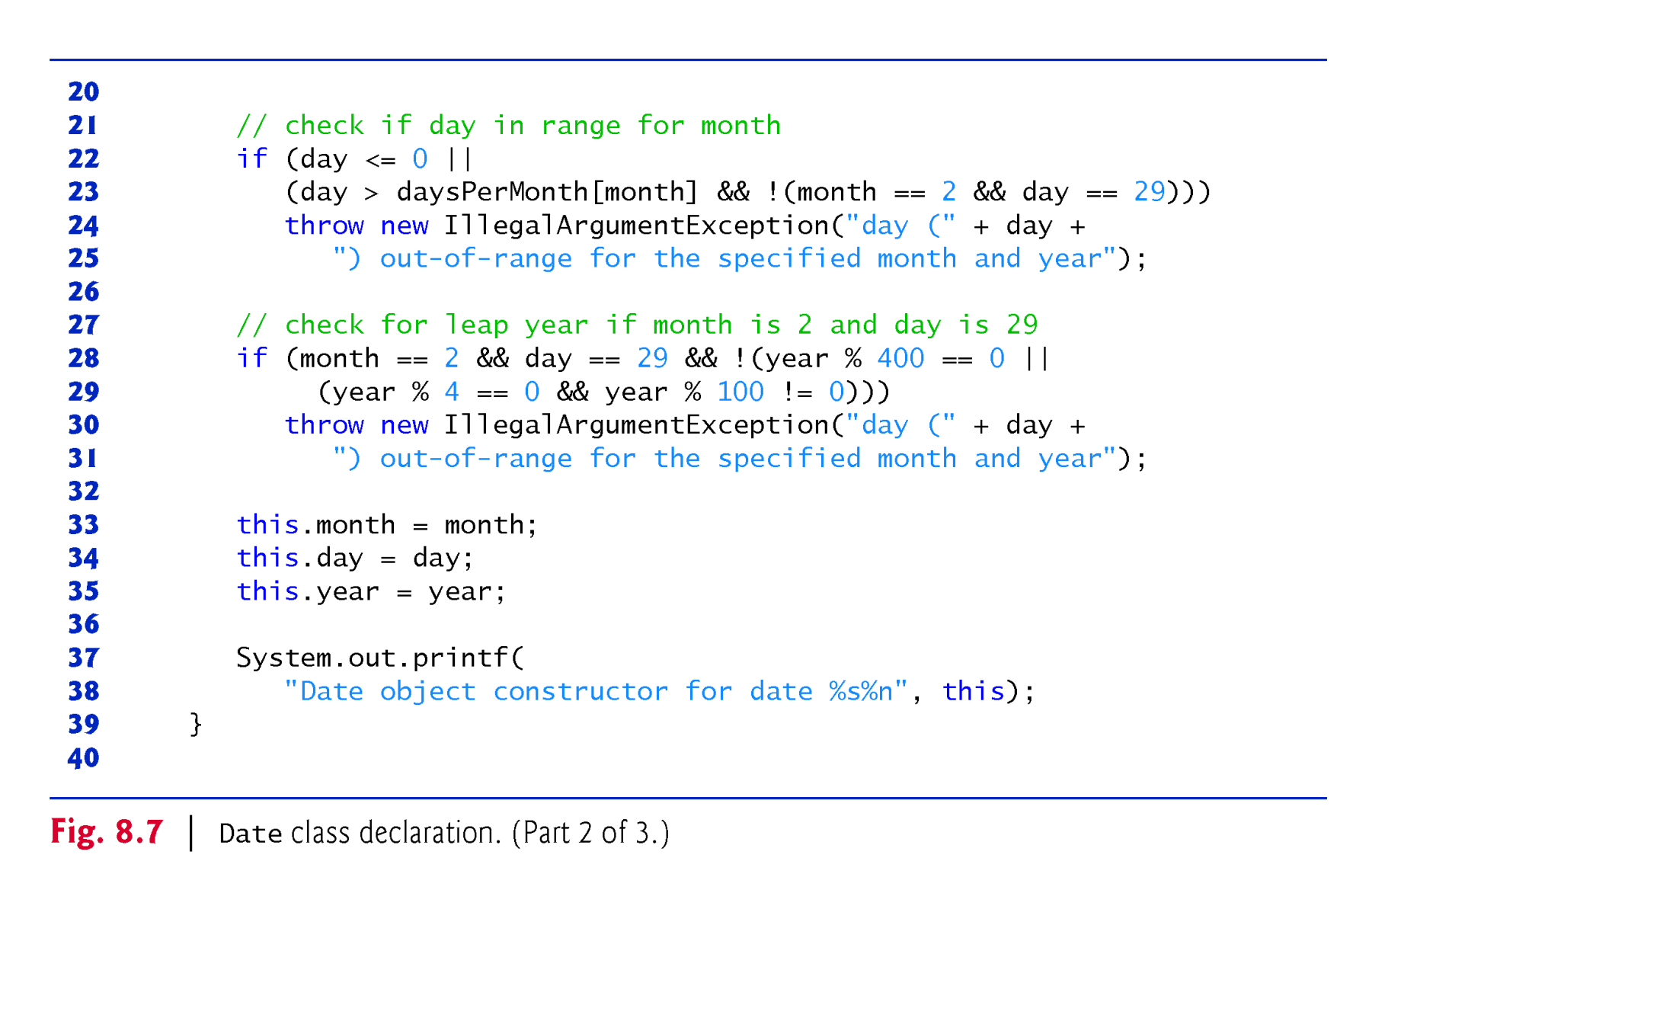
Example 5 for Has-A : Date class(2/3)
Line 37:System.out.printf
(“Date Object Constructor for date %s%n”, this.toString() );

Slide 24
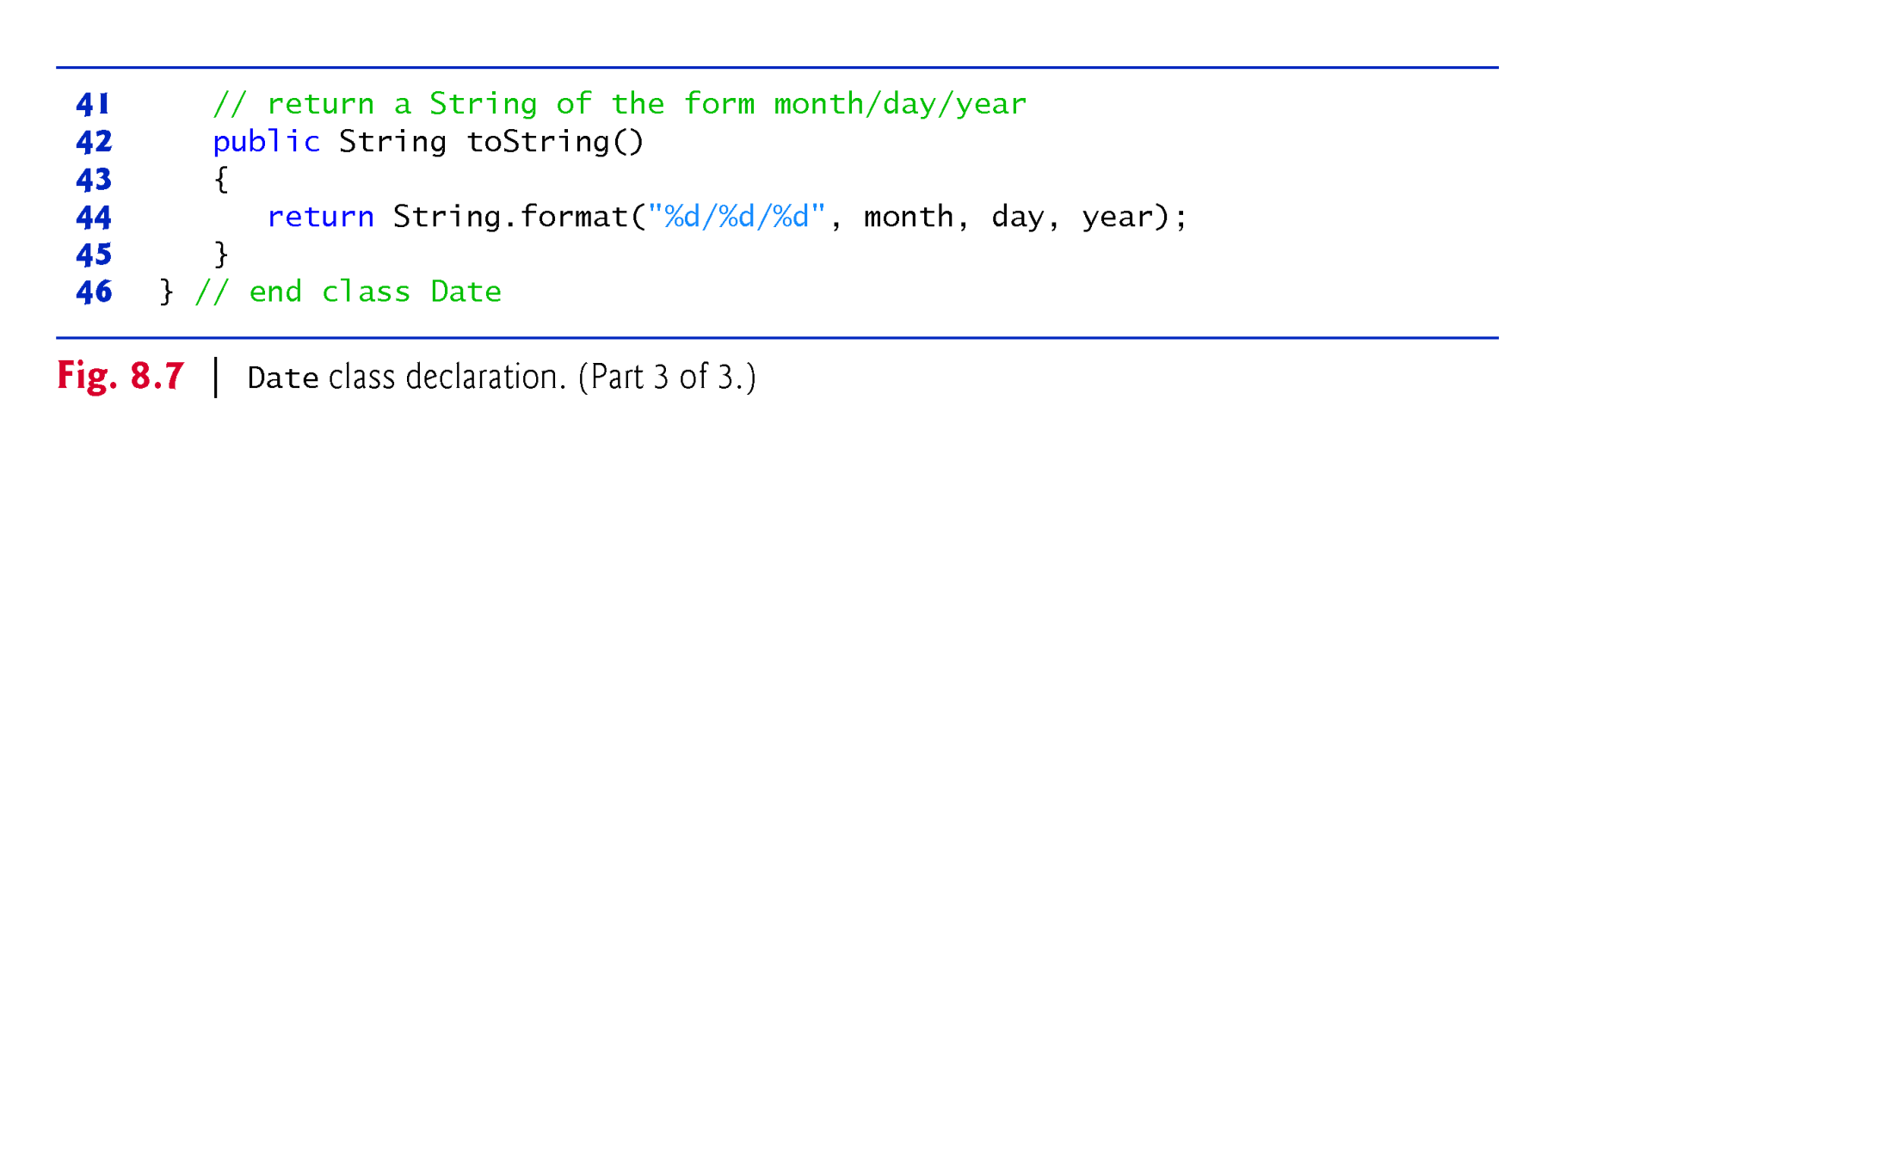
Example 5 for Has-A : Date class(3/3)

Slide 25
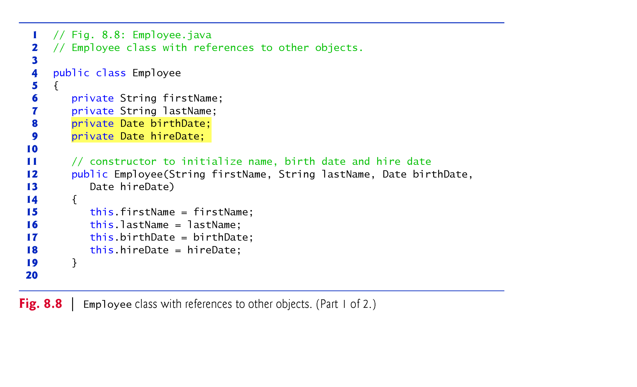
Example 5 for Has-A : Employee class(1/2)
Line 8/9: Employee class has Date class as member variable
Note: Can non-static member variables ( line 6-9) can be marked final ?
Answer: for each employee object, they are not modified after initialized

Slide 26
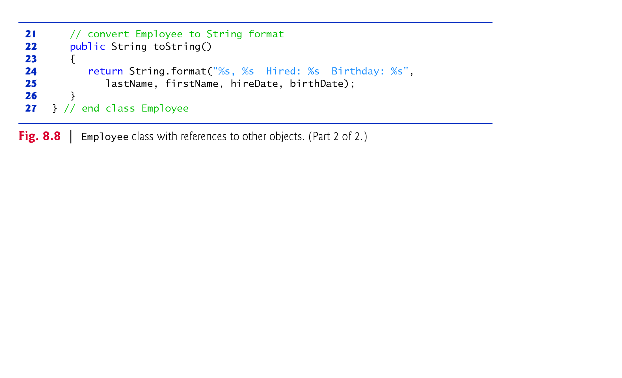
Example 5 for Has-A : Employee class(2/2)
Line 24: return String.format(“ %s, %s Hired: %s Birthday: %s ”, lastName.toString(), firstName.toString(),hireDate.toString(),birthdate.toString()

Slide 27
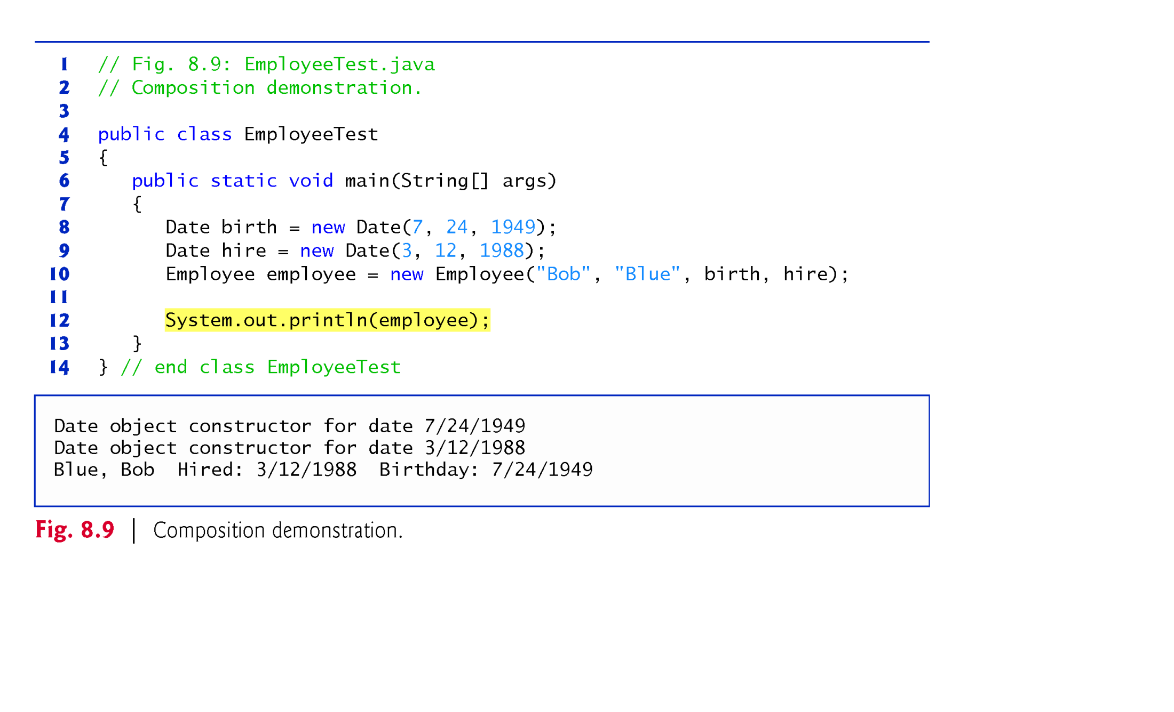
Example 5 for Has-A : EmployeeTest class

Slide 28
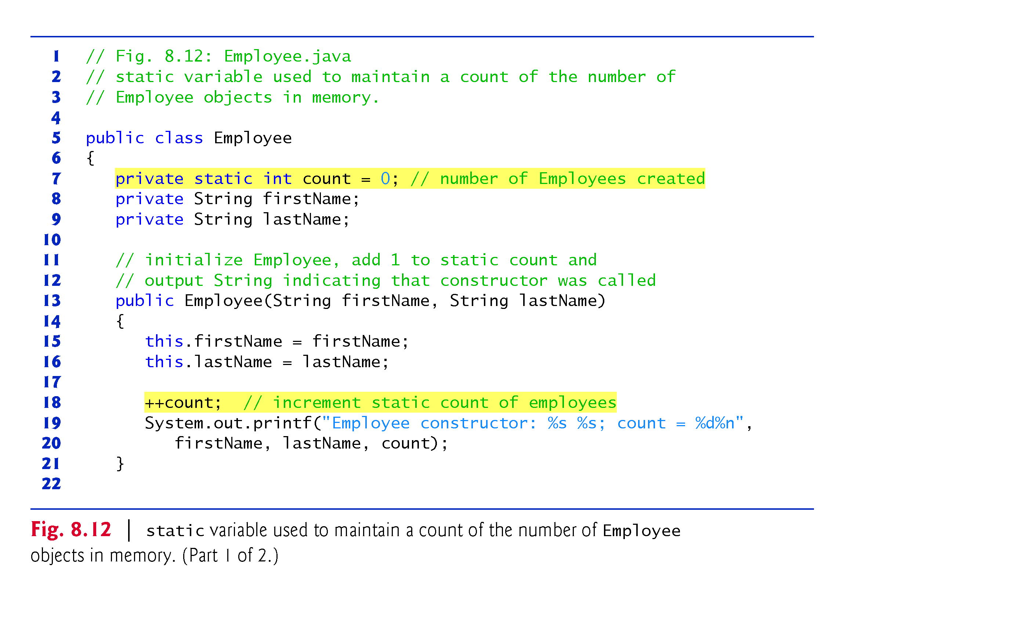
Example 6: Scope of static Class Members(1/2)
This program tracks the number of objects created

Slide 29
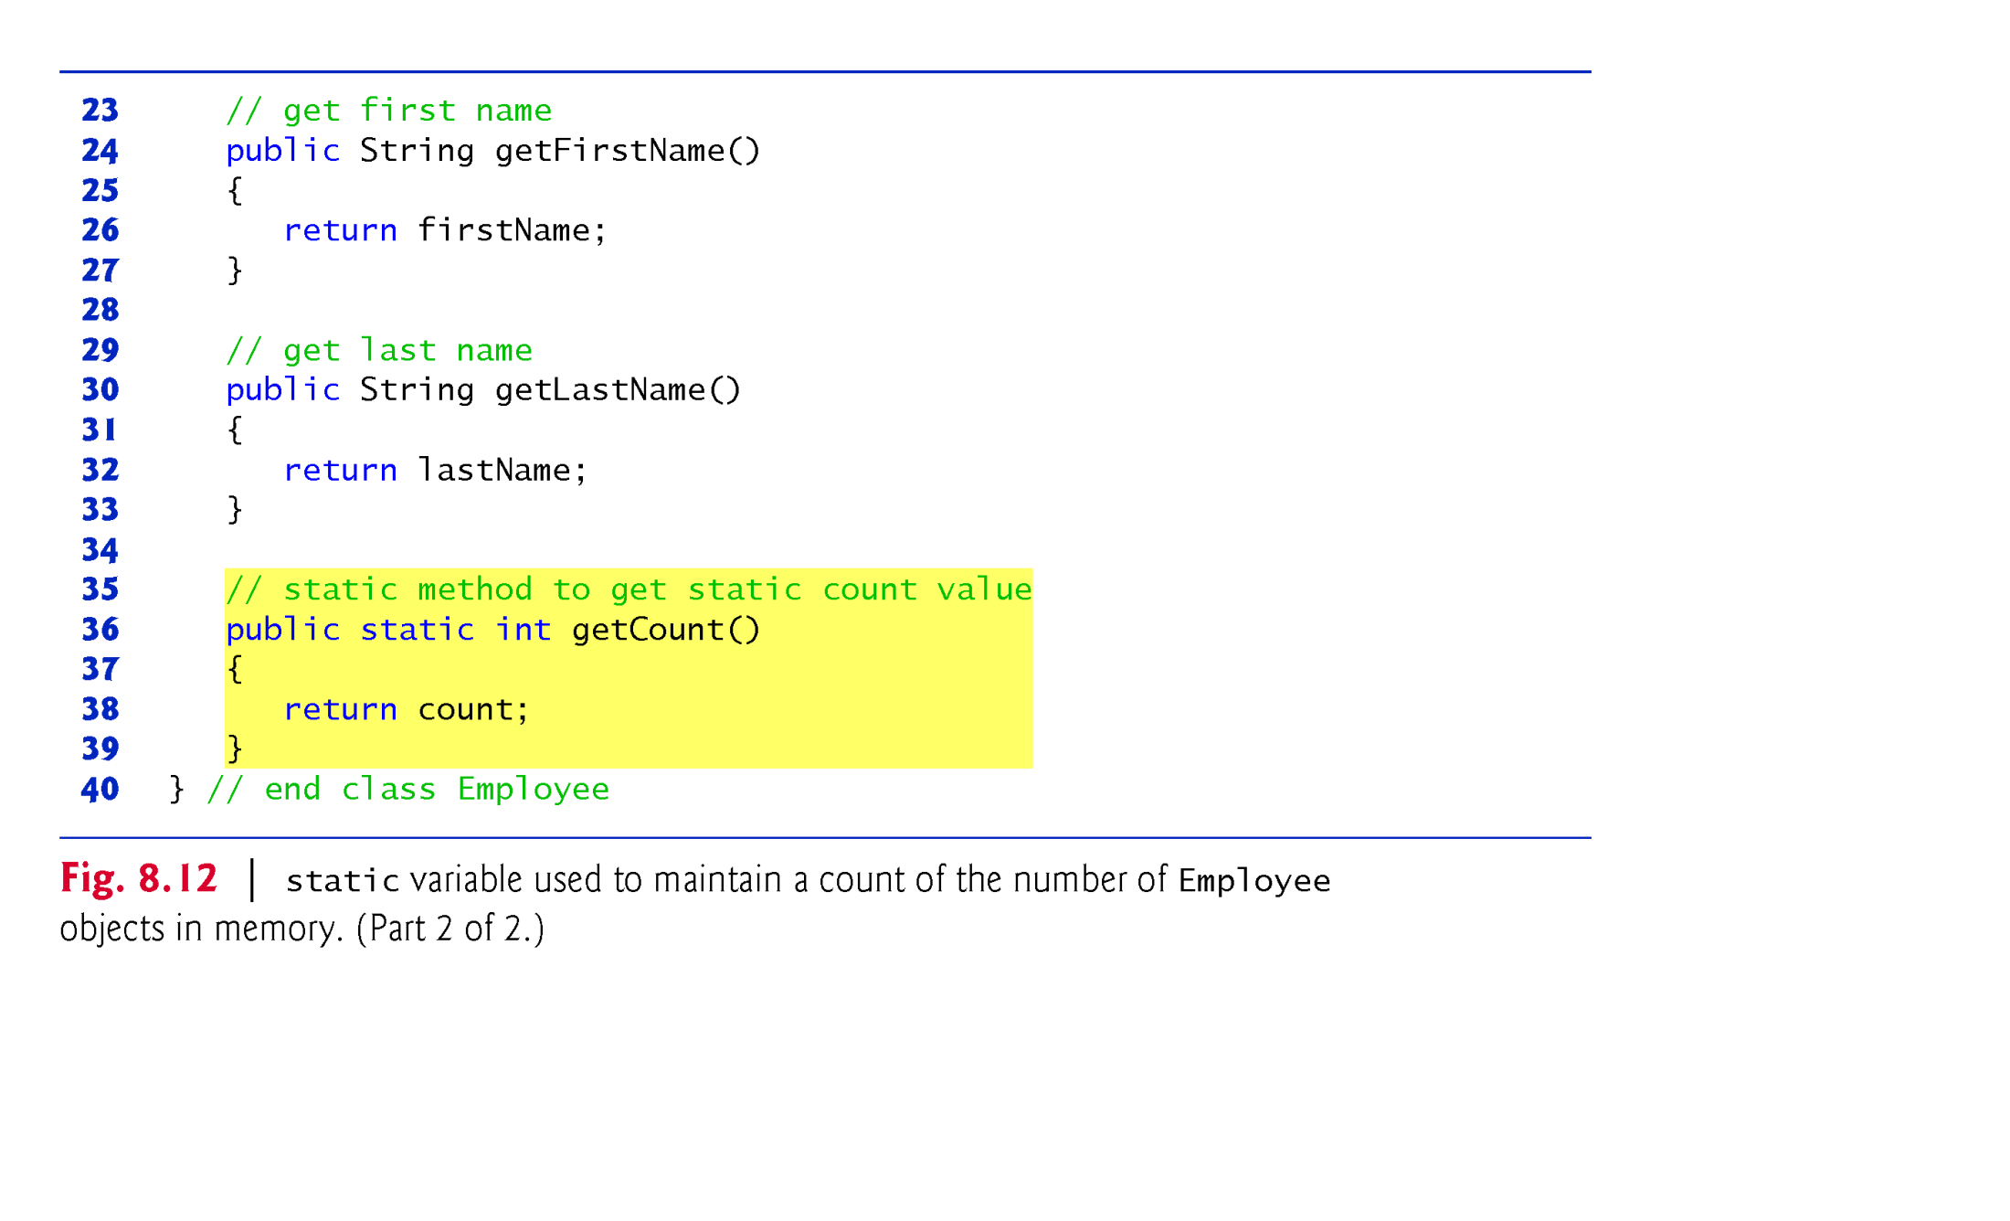
Example 6: Scope of static Class Members(2/2)

Slide 30
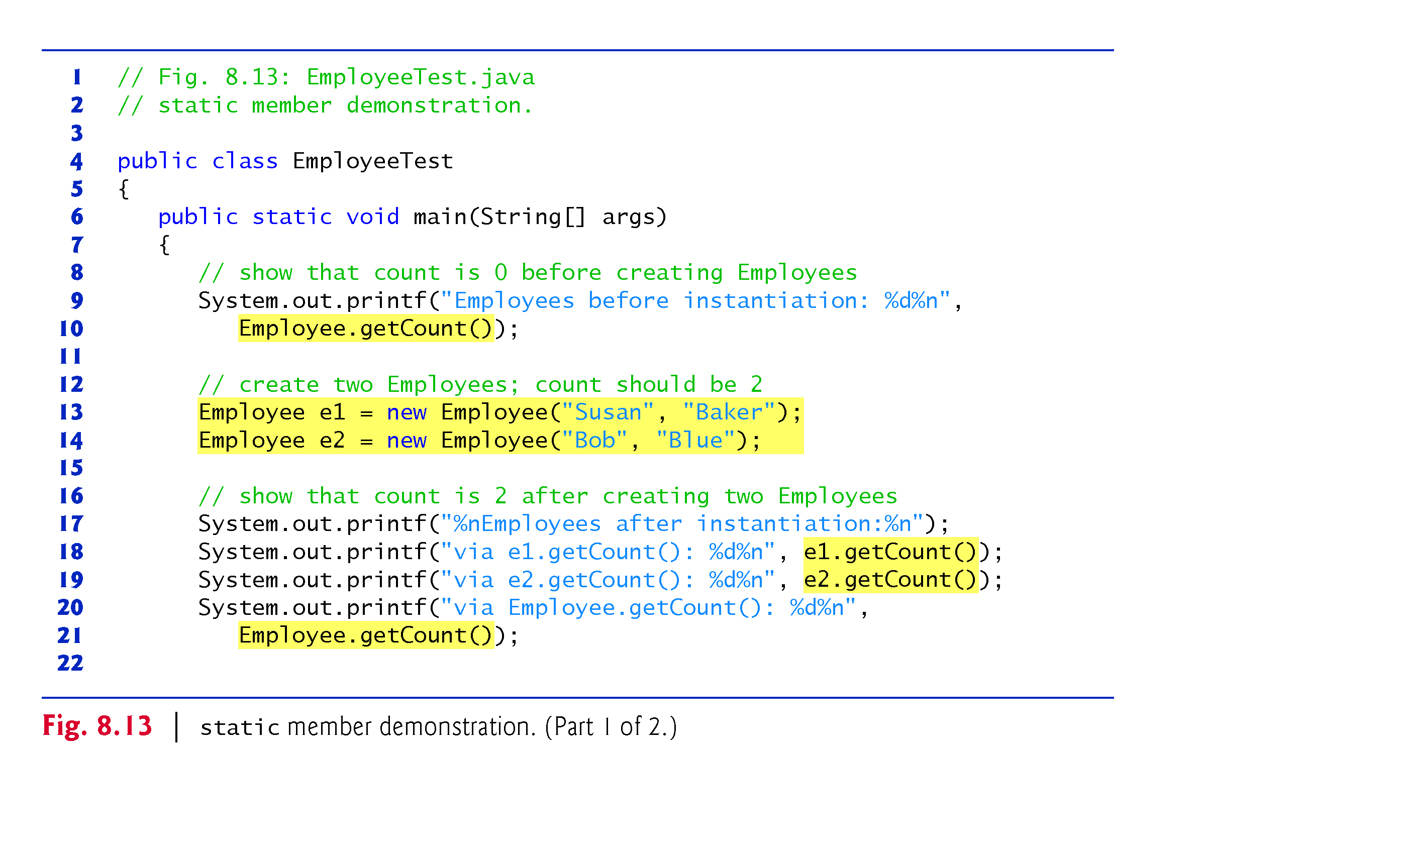
Example 6: Scope of static Class Members(1/2)
After main() is completed, e1 and e2 removed from stack and then objects from heap will be removed by Garbage Collector

Slide 31
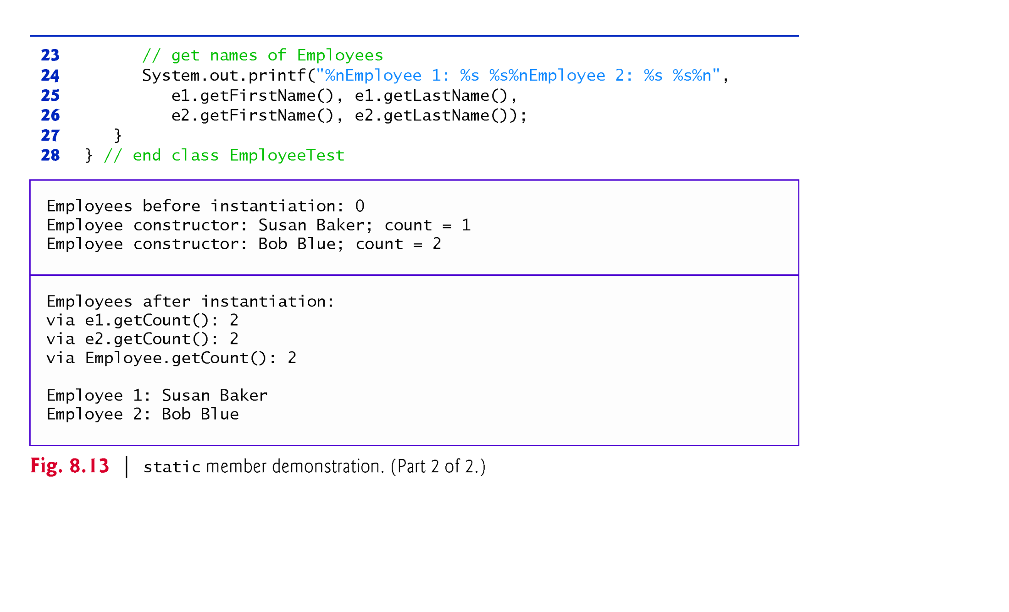
Example 6: Scope of static Class Members(2/2)

Slide 32
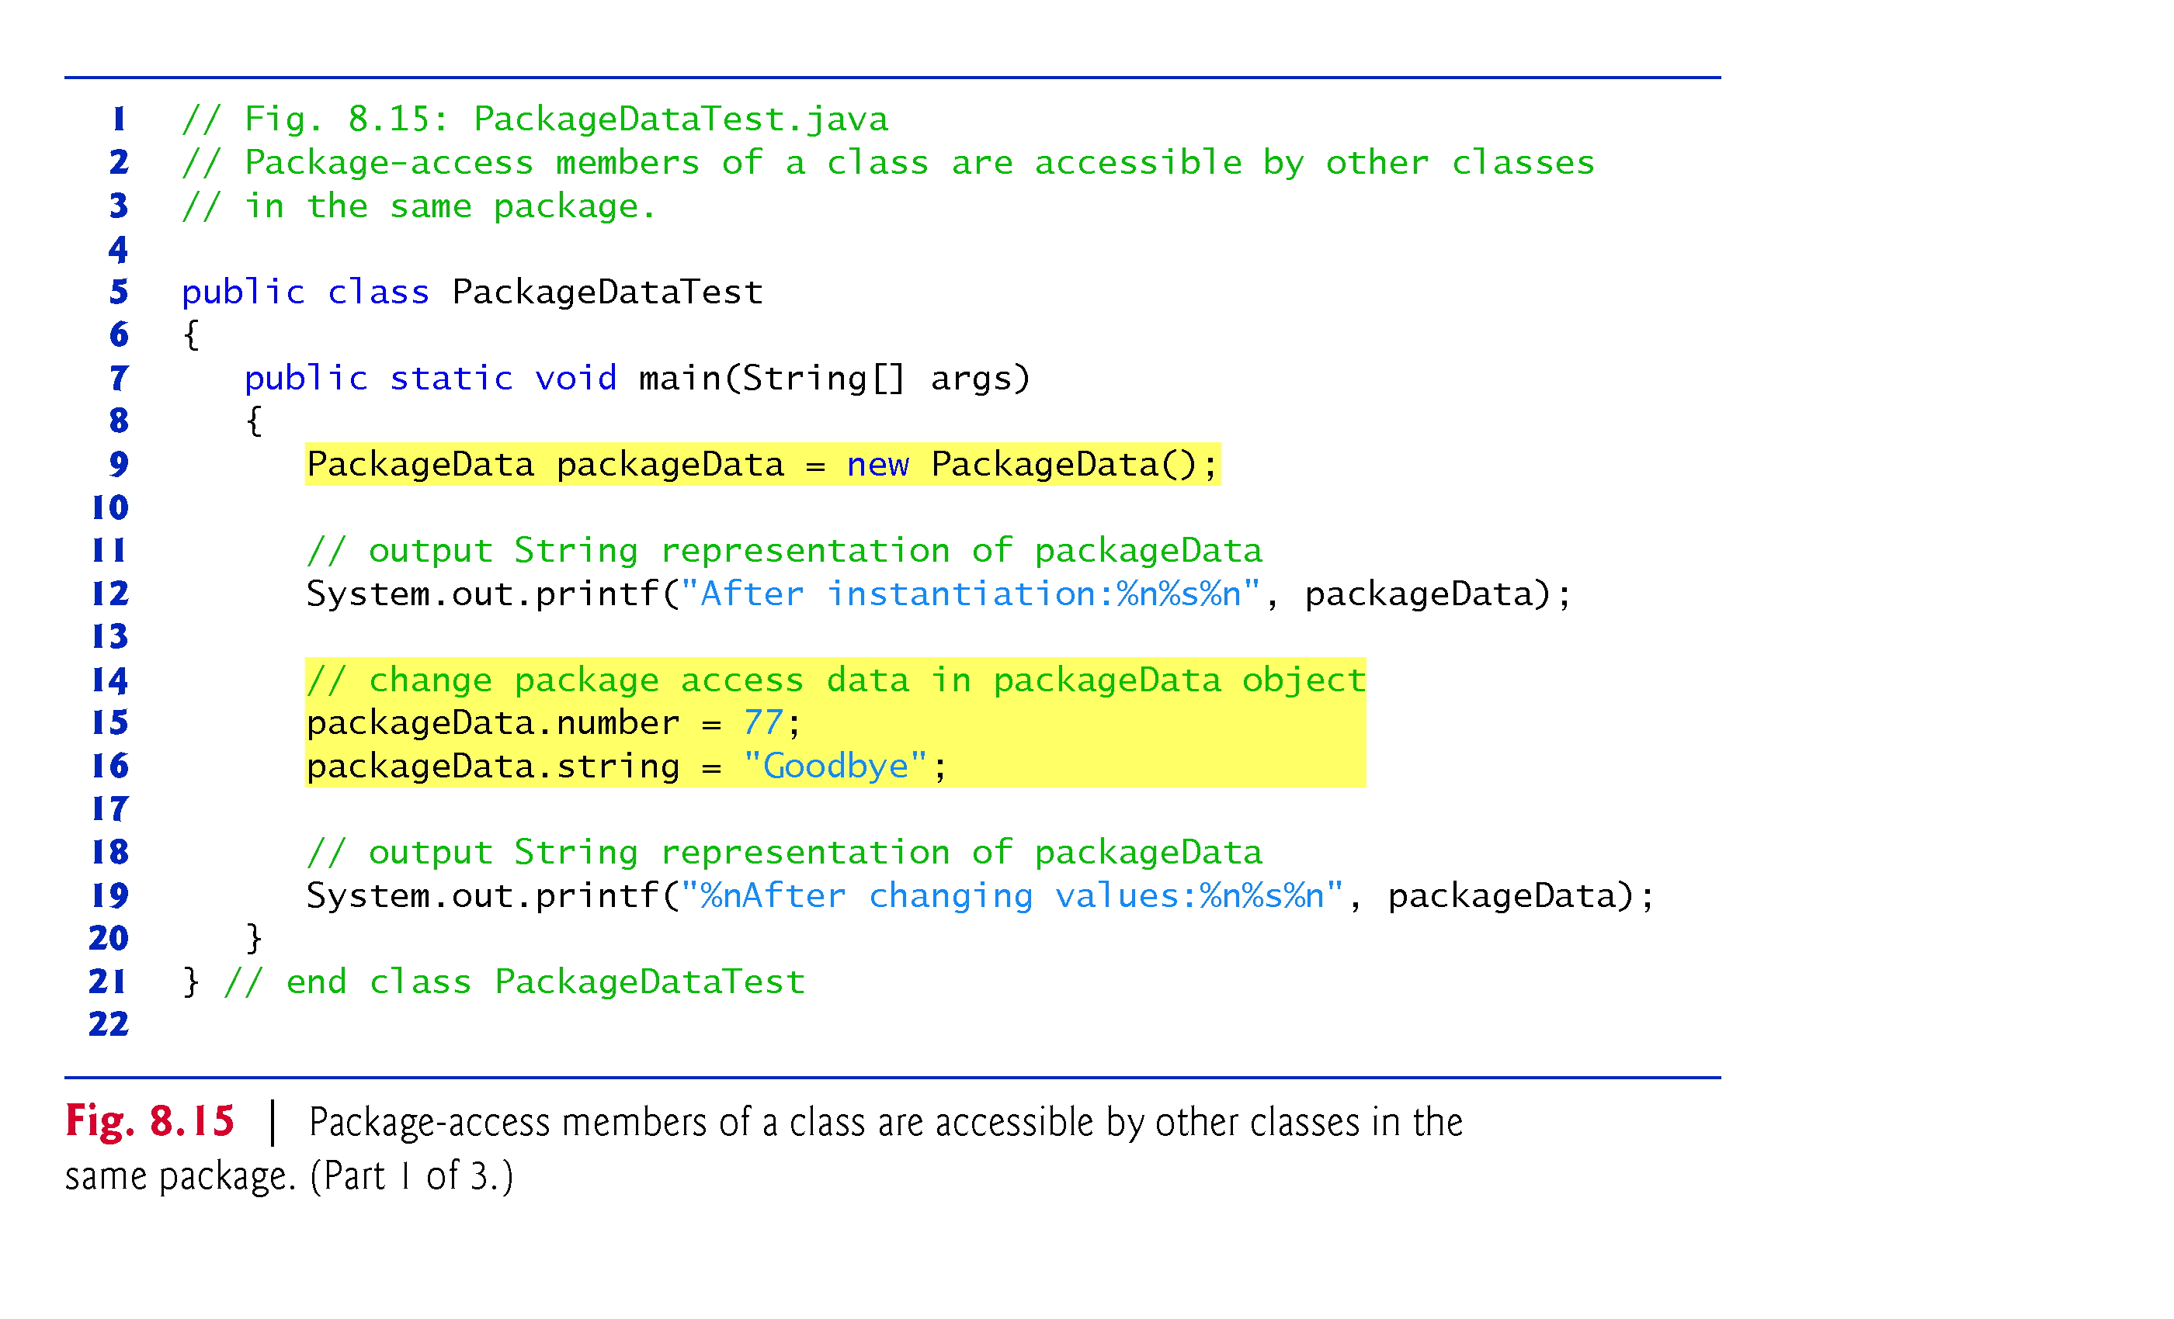
Example 7: Package Access level (1/3)
Note: line 15-16: Client code access member variables of server class directly even if they have no public access modifier

Slide 33
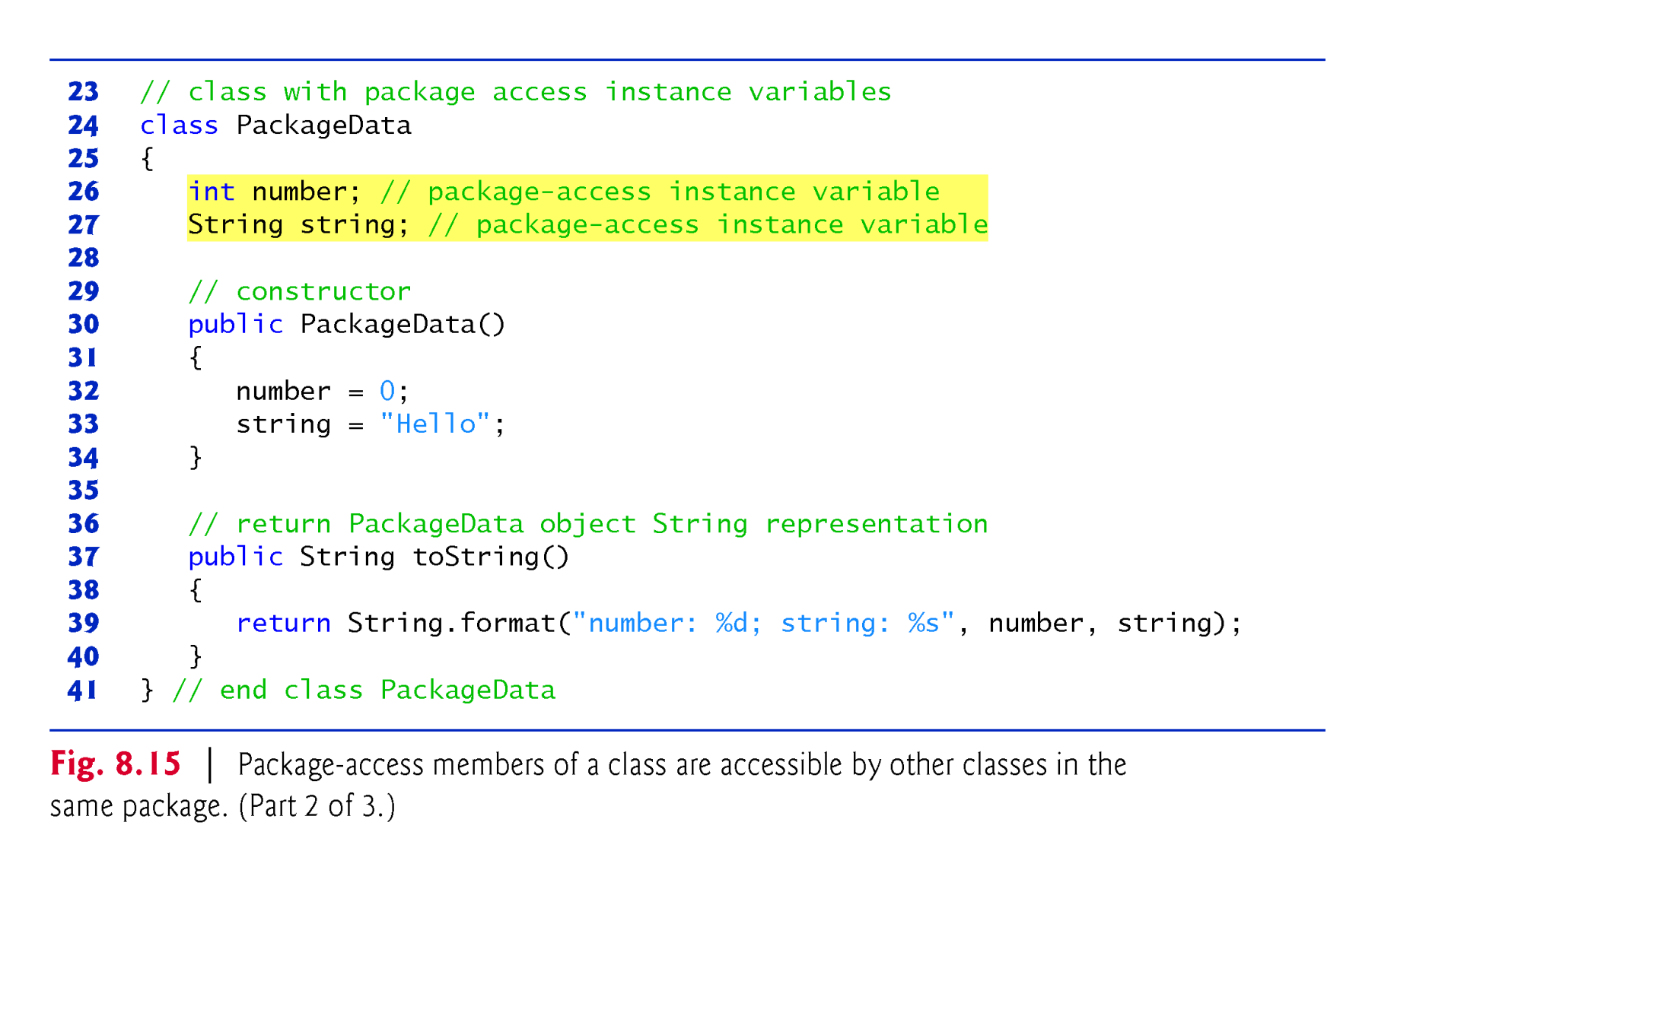
Example 7: Package Access level (2/3)
Note: Line 26-27: There is no access modifier for member Variables

Slide 34
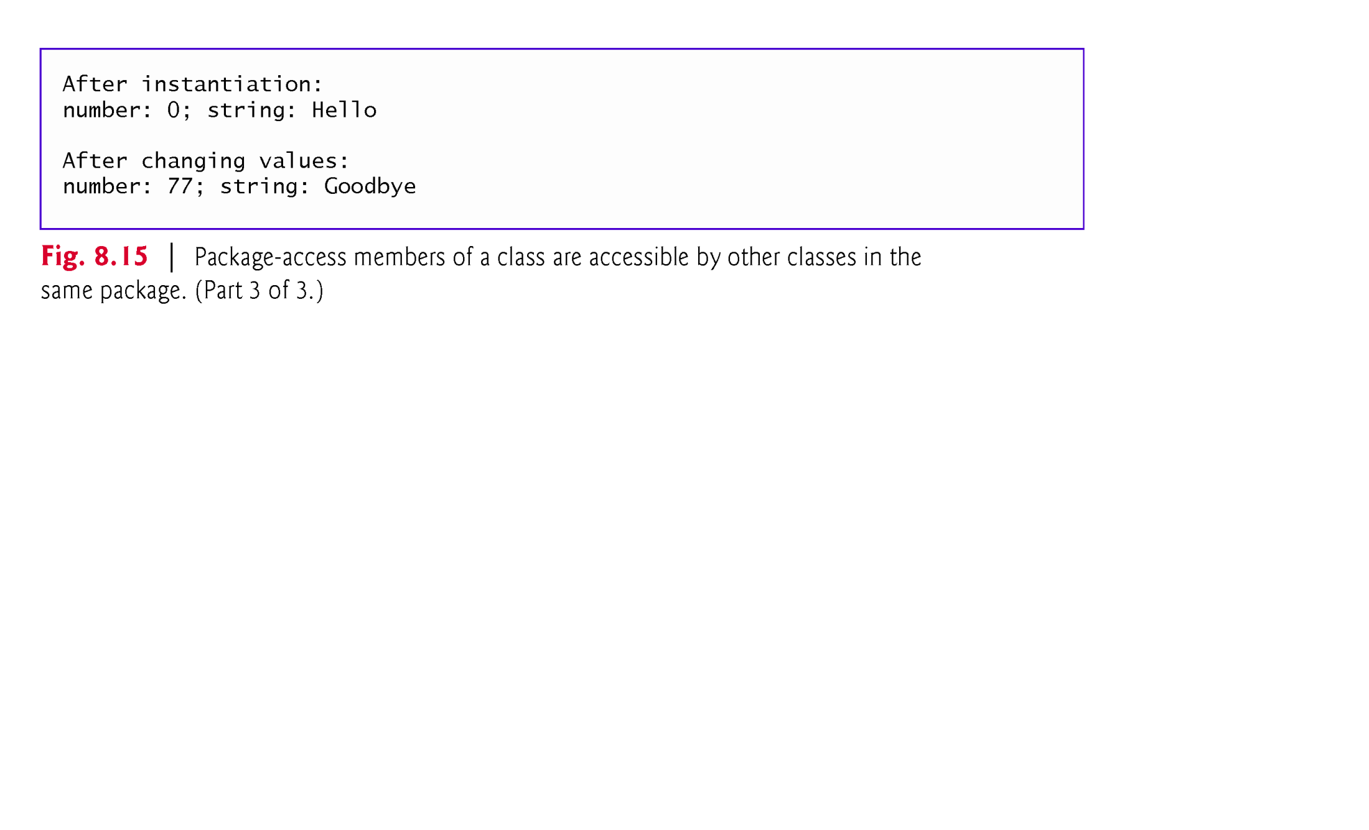
Example 7: Package Access level (3/3): output

